Slide 1
Preparing for Presentation

Slide 2
Awards
o 1st Place $1,800
o 2nd Place $1,400
o 3rd Place $1,000
o 4th Place $800
o People’s Choice/Joss Award $400
O Betty Noble Entrepreneurship Award $500
Notes:
Relate to them – ordinary story
Emotional story or examples
Positive motivation – envision the future …. Problem solved…. Desires What would if feel like if this was solved?
Negative motivation – What will happen if this is never solved?

Slide 3
VOICE CHARACTERISTICS
The pitch and speed of speech.
Voice quality can be used to bring excitement and drama to the presentation by doing three things:
  varying the pitch
  fluctuating the speed, and
  altering the volume.

Slide 4
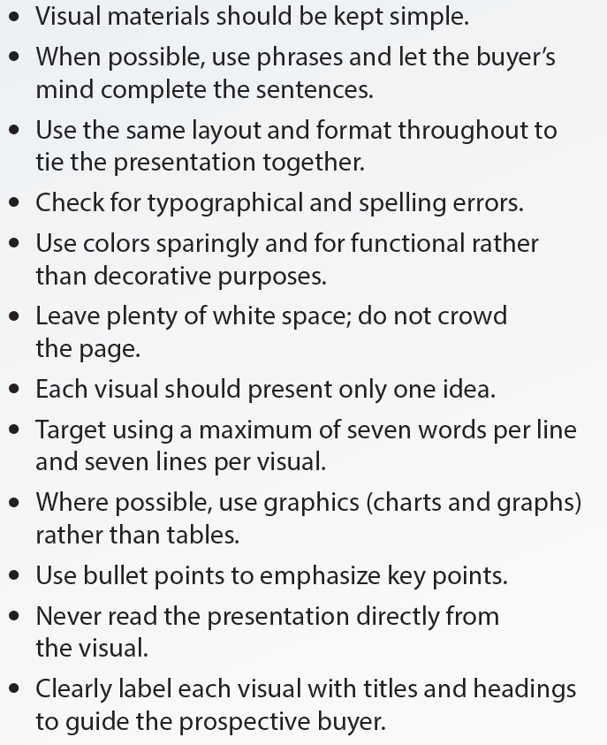
Tips for Preparing Visual Materials
Notes:
.

Slide 5
Slide #1 and #2

Slide 6
Pitch Slides #1 & #2
Defines the problem that your business is solving.
Describes the situations and forces that are causing the problem and provides facts that further define the scale and scope of the problem.
Identifies the stakeholders to the problem and describe how the problem is affecting them. (potential customers, community)
Explains how your business will provide a solution to the problem and how this is different than what is currently available, and how your solution provides value to your customers.

Slide 7



Slide 8
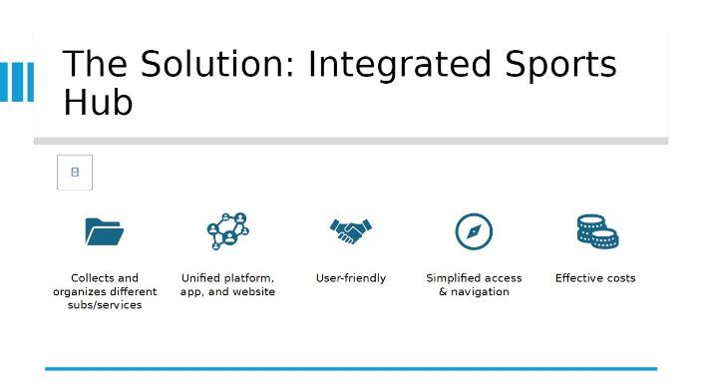


Slide 9
Slide #3
Target Market

Slide 10
Slide #3 – Target Market
Who is your target market? Please describe your target market using the four basis of market segmentation: demographic, geographic, psychographic, and behavioristic.
Please give an estimate of the size of your target market, the potential demand, and the initial market capture rate.
Please identify your three major competitors, describe each of their strengths and weaknesses in the marketplace, and explain how you are different from them and the value that you will provide to entice your target market to choose you over each of your three major competitors

Slide 11

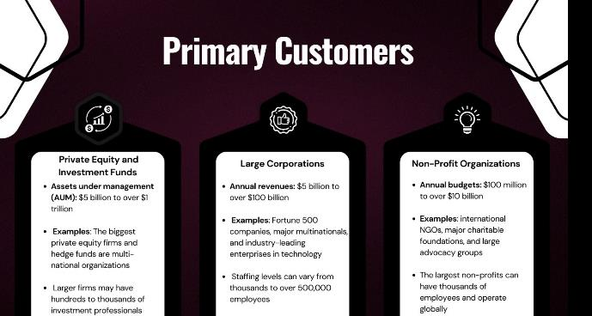

Slide 12
Slide #4
Start up Costs

Slide 13
Slide #4 – Start up Costs
What are the estimated start-up costs?
What are your revenue sources and your profit potential?
Why will your business be successful?
(Please use the elements of a persuasive argument in stating your case: present your position clearly, establish your authority with credentials and experience, support your position with evidence using facts, statistics, quotes, and examples, disprove any opposing viewpoints, and state conclusions.

Slide 14
