Slide 1
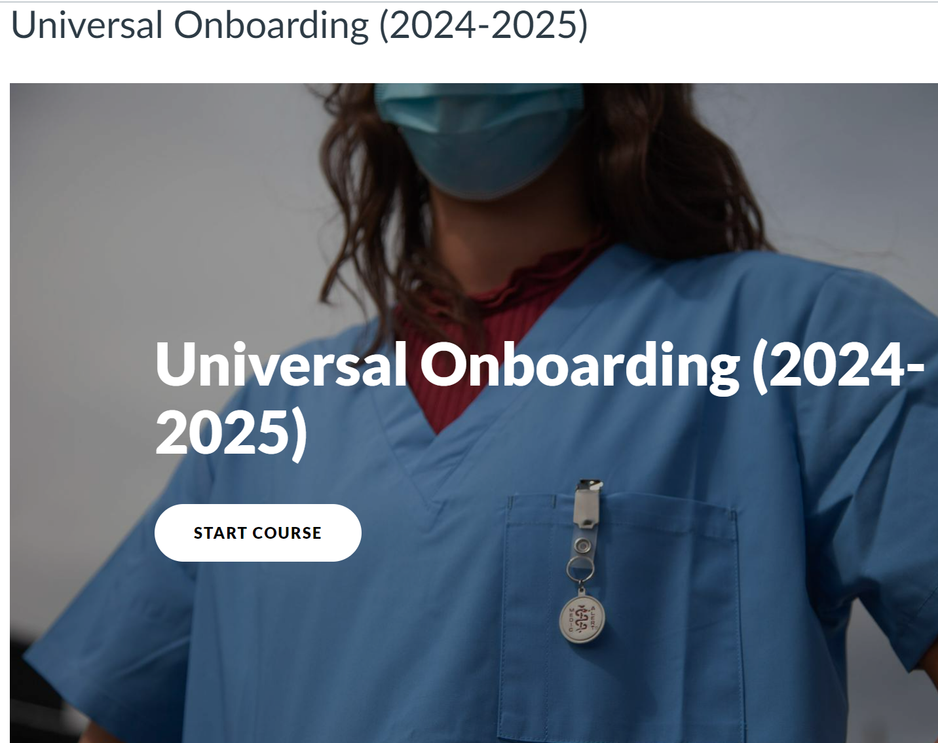
Click on this Link to see the Universal Onboarding Assignment in Canvas
Next Page

Slide 2
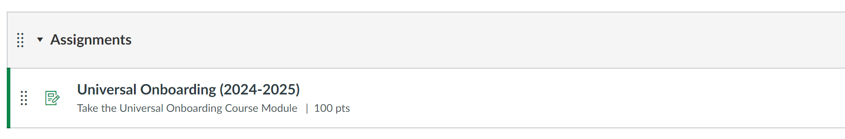
"Now, click the assignment to proceed to the welcome page."

Slide 3
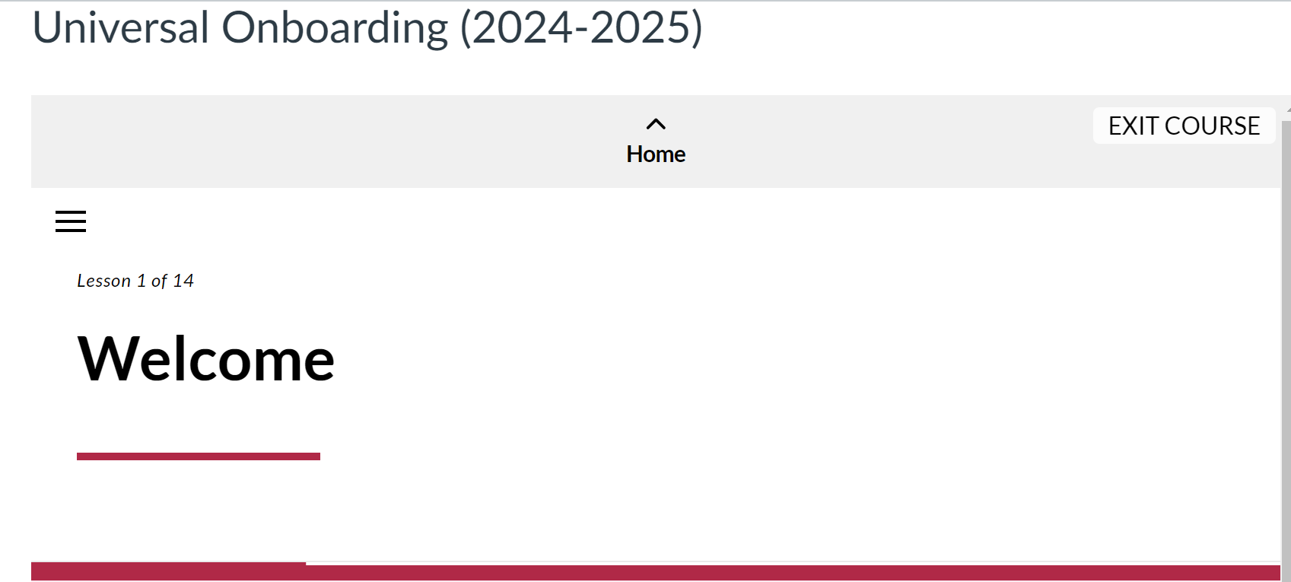
"Scroll down the welcome page and click on the modules to begin."

Slide 4

Completion Timeline: Completion of the UO modules is due annually but the due date for this assignment may vary depending on the program and access to Canvas. If you have any questions, contact the Clinical Liaison Office or your clinical instructor.

Slide 5
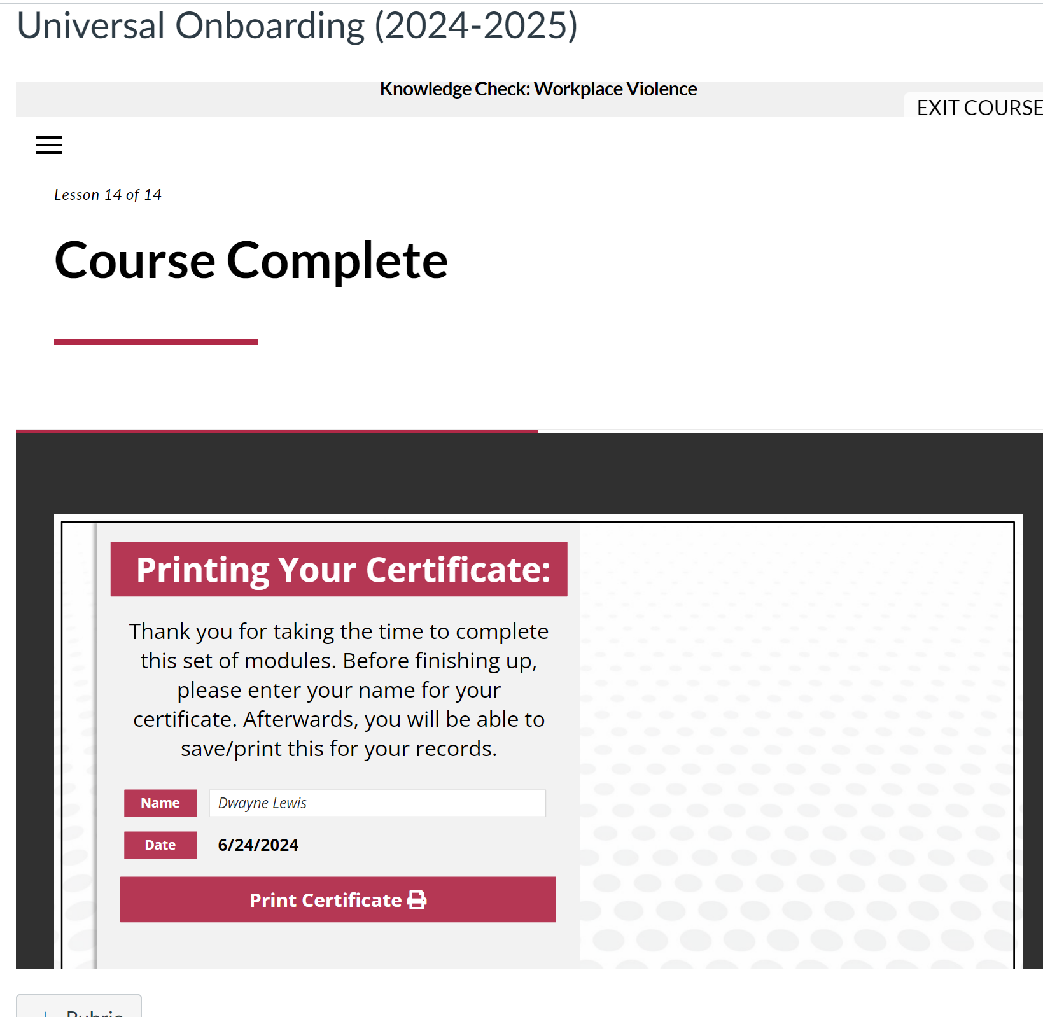
After completing all modules, you will be prompted to print a certificate of completion. Certificates of completion must be uploaded into CastleBranch to ensure compliance.

Slide 6
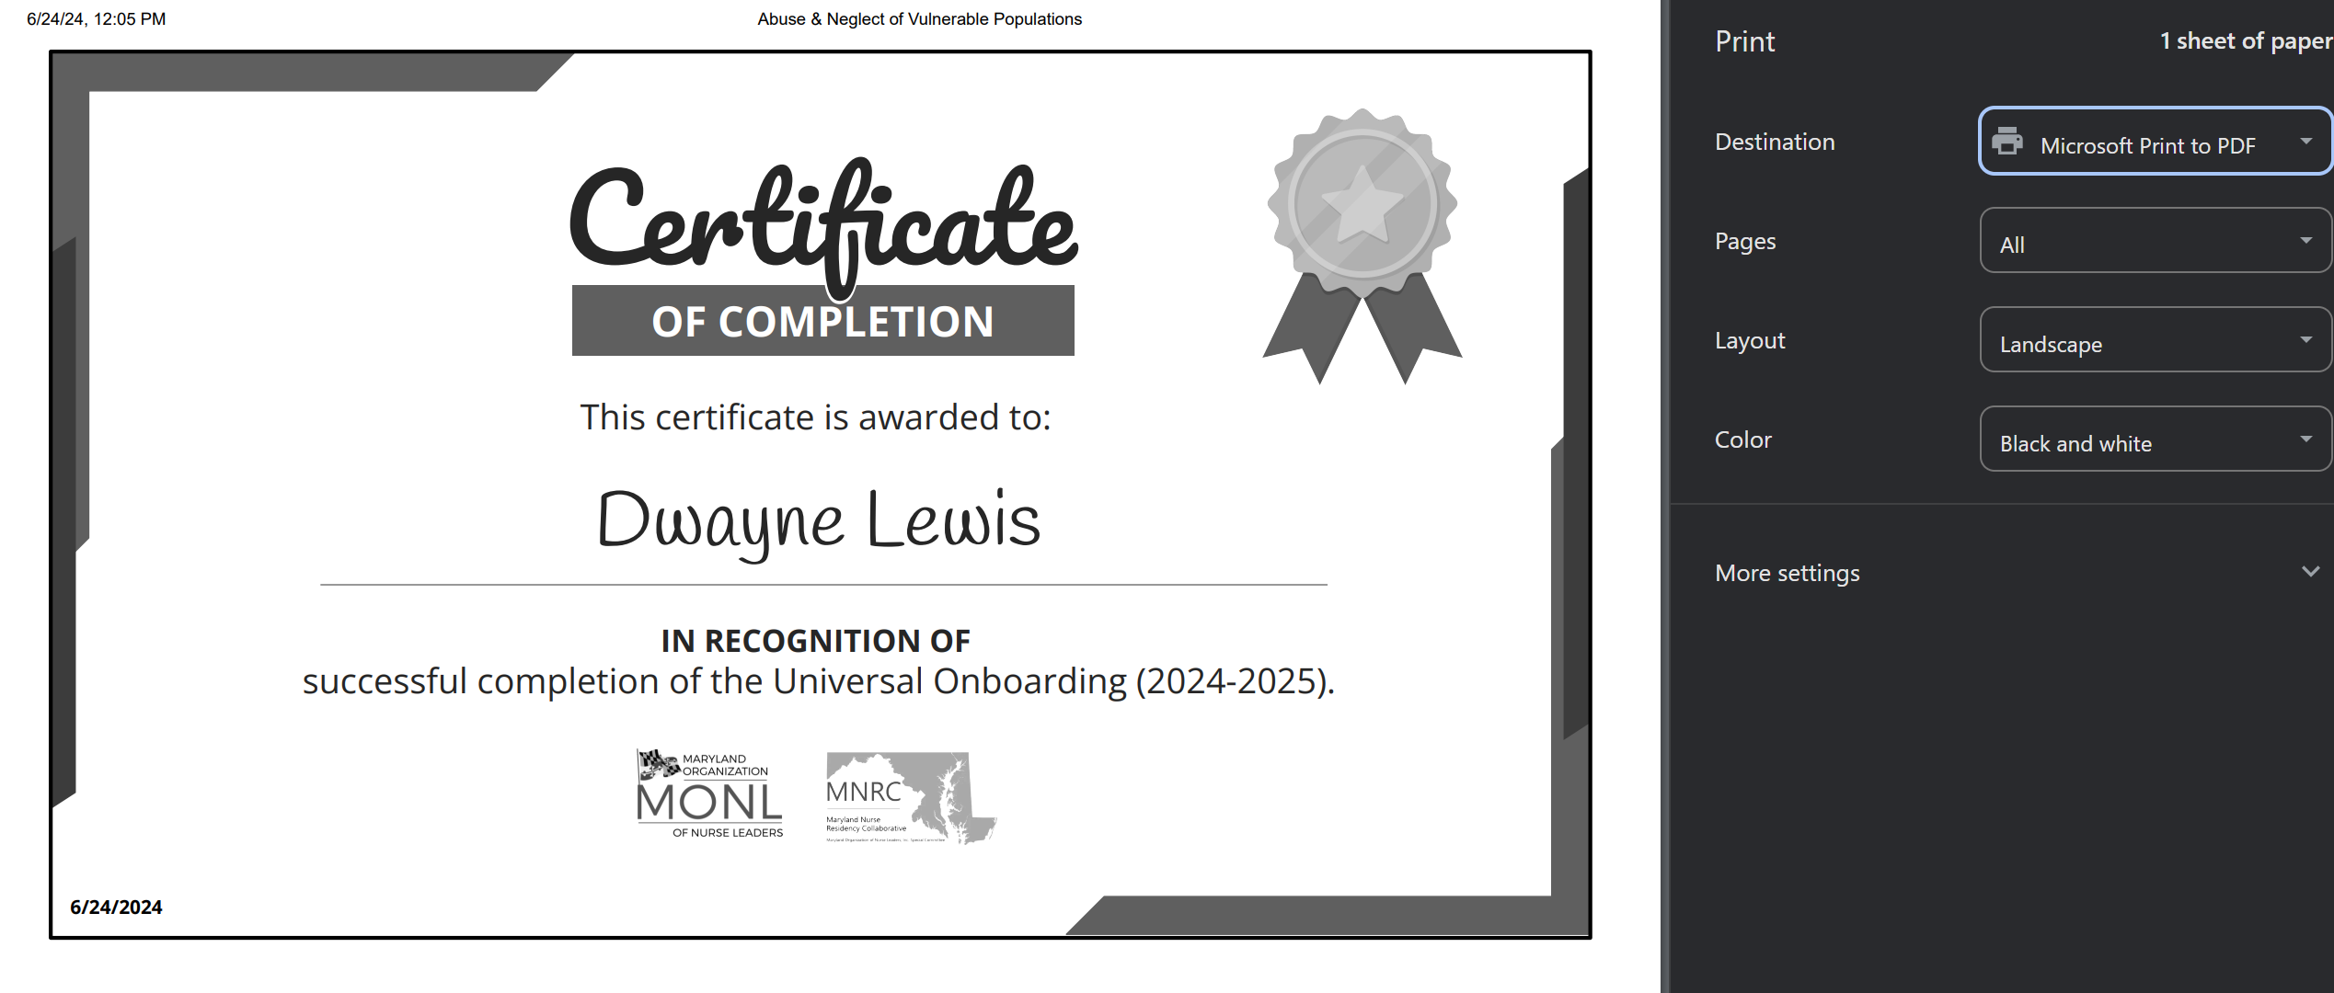
Please set your print destination to Microsoft Print to PDF. This ensures you can download your certificate into CastleBranch Digitally. Ensure your settings are correct to avoid any issues with documentation and compliance.

