Slide 1
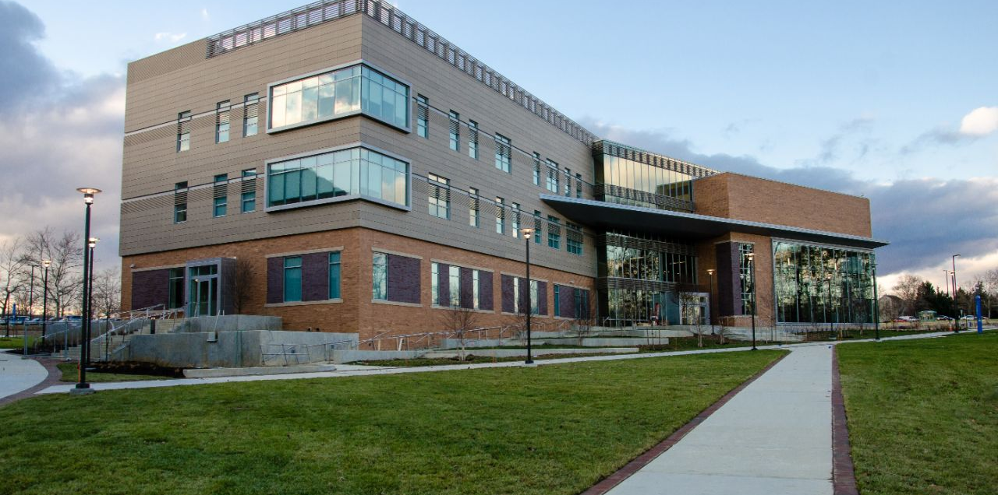

Medical Requirements:
An Overview for Students
Howard Community College’s
Health Sciences & Technology Division & Clinical Liaison Office

Slide 2
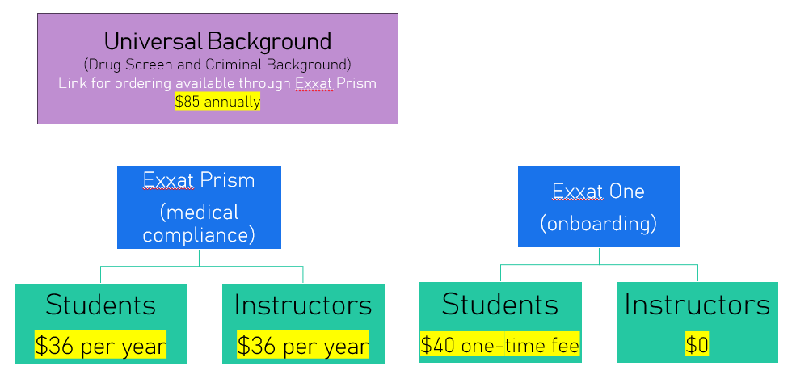
Pricing Summary

Slide 3
Criminal Background Check/Drug Test
The ONLY acceptable Criminal Background Check is through Universal Background (Universal)
Time sensitive- should be done at least 3 weeks before the start of classes/clinic
Universal sends the results directly to the Clinical Liaison Office (lab slip needed)
If you have a prescription for a legal drug, you will need to present it to a Medical Review Officer (MRO)
Medical marijuana cards are not accepted

Slide 4
Immunizations/Vaccines
including Measles, Mumps, Rubella, Varicella, Tetanus Diphtheria Pertussis (Tdap)
If you have records showing a vaccine or vaccine series, submit them to Exxat Prism
If your Tdap vaccine falls outside of an 10-year window you must retake the vaccine/booster
If titers are negative or equivocal you must turn in proof of a booster
Lab results must be uploaded to Exxat Prism
Notes:
Blood titers are required for Measles, Mumps, Rubella and Varicella. Immunization records are not sufficient proof of immunity and do not replace blood titers. Please obtain a copy of the lab results from your doctor and attach to your health form. Please note that you need a separate lab value for all of the listed immunizations. Proof of immunity is what is required not proof of immunizations.

Slide 5
Hepatitis B
One of the following is required: 3 dose series OR 2 Heplisav-B vaccinations required OR Positive Surface Antibody titer lab report
Declination waiver If your titer was negative or equivocal, please consult your Health Care Provider on repeating the 3 dose or 2 dose HepB series
If your HepB series is in process, please upload a declination waiver (available here)
Notes:
Hepatitis B is highly recommended. If you have had the series of three shots and have a titer result list the dates on page 4 of the health form. If you have had the shots but not had a titer then have the titer drawn as stated above. Attach lab result to the health form. You may choose to start the series of injections and list the date that you received the injection on the health form. You may bring the health form in at anytime there after with page 4 signed at the bottom and the appropriate item checked. As you receive the other two injections please bring documentation to the HSDCC. As stated in slide 4-6 weeks after the third injection please have a titer drawn and submit results to the HSD clinical coordinators.

Slide 6
Ongoing Requirements
Tuberculosis (TB)
You are required to have baseline proof of a negative TB test (2-Step skin placement test, QuantiFERON®–TB Gold blood test (QFT-GIT) or T-SPOT TB blood test (T-Spot) upon admittance to the program
This is an annual requirement – upon renewal, you will need one of the following: a 1-step PPD, QuantiFERON®–TB Gold blood test (QFT-GIT) or T-SPOT TB blood test (T-Spot)
If you have had a positive PPD, you must produce a clear chest X-ray which is good for 5 years
Notes:
PLEASE NOTE that some facilities are providing TB screening through a blood test called QuantiFERON®–TB Gold test (QFT-GIT) or T-SPOT TB test (T-Spot). PER CDC, THIS IS AN ACCEPTABLE SCREENING AS WELL, AS IT IS A BLOOD TEST, AND ONLY REQUIRES ONE READING.

Slide 7
Seasonal Flu
Flu season is from August-May.
Spring admit students are required to provide flu vaccination documentation to be submitted with their health documents.
Fall admit students will provide documentation after they begin classes. Flu shots are due 10/1 each year.
STUDENTS ADMITTED IN A SUMMER PROGRAM WILL NOT NEED PROOF OF THE FLU VACCINE UNTIL FALL.
Notes:
You may get the flu vaccine at your doctor’s office or at a local pharmacy or clinic. Please make sure you are getting the vaccine that is for the current year. Please note if you are a Summer N140 student and are taking the LPN completion course, you will need to submit proof of a seasonal flu vaccine if we did not receive before.

Slide 8
Basic Life Support
You must upload proof of Healthcare Provider Level Basic Life Support (BLS) certification to Exxat Prism
Your BLS certification must be renewed every 2 years
BLS Training must have an in-person component
HCC offers BLS certification here
Notes:
As you can see American Heart Association Basic Life Support for the Health Care Provider is the CPR class you must take. If you have something different from your place of employment you must check WITH THE HSD CC to see if it is acceptable.
DO NOT ASSUME that your CPR is acceptable if it is different from AHA Health Care Provider (BLS)!

Slide 9
COVID- 19
Please upload proof your most recent complete COVID-19 vaccination. Both cards and online documentation are accepted

Slide 10
Health Insurance
All HCC students are required to have Health Insurance
Open enrollment for Maryland Health Connection in November
https://www.marylandhealthconnection.gov/
HCC’s HR department flyer called student health insurance plans

Slide 11
Health Form
Student Health Forms (available here) must be filled out within your Exxat account.
A Physical is not required by most facilities.
If you are pregnant or have a medical condition you must have your Health Care Provider write a statement that you are cleared for clinical and have it signed and dated.

Slide 12
Universal Onboarding
(UO)
You must have access to Canvas before you can access the Universal Onboarding (UO) modules.
After you have completed the 11 UO modules and scored at least 80% on each quiz, upload your certificate of completion to the Exxat Prism tracker.
PPT containing link to Canvas modules and attestation can be found on our Health Form & Resource Website

Slide 13


Mid-Semester Compliance
If you become non-compliant at any point during a semester in progress, you cannot continue until you fix the issue.
The best practice, if possible, is to ensure everything is up to date before the semester starts and will remain so for the entire semester so there is no overlap or delay in compliance.

Slide 14
Onboarding with Exxat
Most nursing and some allied health facilities use Exxat One for onboarding
If you are attending one of these facilities for clinic, you will need to purchase Exxat One for a one-time fee of $40
When medical compliance and onboarding paperwork is complete, you will be cleared for clinicals

Slide 15
H&SD Clinical Liaison HOTLINE: 443-518-1561
E-mail: hsdcc@howardcc.edu
Office: KHH 354
Nina Campbell, Senior Clinical Liaison <ncampbell@howardcc.edu>
Jo Hutchison, Senior Clinical Liaison <jhutchison@howardcc.edu>
Darby McKaine, Clinical Liaison <dmckaine@howardcc.edu>
If you need to access our health forms, please refer to following web page:
https://www.howardcc.edu/programs-courses/academics/academic-divisions/health-science-and-technology/health-sciences/resources/
Notes:
Once you have completed viewing this PPT presentation, if you have any questions, please do not hesitate to contact us.
Please feel free to contact us via e-mail. We will reply to you ASAP. If you need to turn in paperwork, please feel free to take to the
Health Sciences Division office in HS-236 (443-518-1560) 8a-8p Monday –Thursday and 8a-5p on Friday.
PLEASE MAKE SURE YOU DO NOT WAIT TILL THE LAST MINUTE TO SCHEDULE YOUR APPOINTMENTS. PLAN AHEAD!

