Slide 1
Sexual Misconduct and Pregnancy: Process and accommodations
David Tiscione
Associate Director of Student Conduct and Compliance, Title IX Deputy
Notes:
Might need to get the keys to this for Super Bowl Sunday!

Slide 2
Overview
Philosophy behind Title IX
Refresher on policies
Discussion about accommodations
Case study
Q+A

Slide 3


Slide 4
What thoughts come to mind when you hear the words Title IX?

Slide 5
What Is Title IX?
“No person in the United States shall, on the basis of sex, be excluded from participation in, be denied the benefits of, or be subjected to discrimination under any education program or activity receiving Federal financial assistance.”
- Title IX of the Education Amendments of 1972
Notes:
JW

Slide 6
What is sexual misconduct?
Title IX:
  Prohibits discrimination on the basis of sex
  Prohibits sexual misconduct and harassment
  Sex can include gender identity
  Prohibits discrimination based on pregnancy and parenting
  Includes any educational activity and any community member
    Admissions, Recruitment, Financial Aid, Academic Programs, Student Treatment and Services, Counseling and Guidance, Discipline, Classroom Assignment, Grading, Vocational Education, Recreation, Physical Education, Athletics, Housing, Employment, and …

Slide 7
These situations can be challenging for faculty…
Following policies and procedures
Desire to be fair to all students
Training and knowledge base may be minimal
Others?

Slide 8
Why do we do this work?
Prevent sex discrimination
When sexual misconduct happens, we want to stop the behavior, prevent its reoccurrence, and address its effects
Keep the student whole
Allow the participants in the process to feel heard and fairly treated
Compliance

Slide 9
What happens if sexual misconduct occurs?
Report it to HCC
  Any non confidential employee
  Public Safety
  Title IX Coordinators
Report it to police
Report it to both
Consult with confidential resources
Third party reporting

Slide 10
Initial interaction with complainant as responsible employee
Notify them:
  You want to hear what they have to tell you
  You want to help and support them
  You are a responsible employee
    You need to share any information about sexual misconduct with the Title IX team
  You want them to have options for next steps
  They can speak with a confidential resource or
  They could continue speaking with you, they could speak with someone from Title IX, or they could speak with Public Safety
  What would you like to do?

Slide 11
Interacting with Complainant
Show empathy
  Believe them
  Say things like “I’m sorry this happened to you”
Remember everyone deals with trauma differently
Avoid showing doubt
Do not victim blame; avoid why questions
Only promise our process
Offer confidential resources

Slide 12
Interacting with Complainant
Trauma informed
  Complainant may have experienced trauma
  Science of the brain may affect actions in the moment of sexual violence and memory afterward
  Memory is not linear, may remember peripheral details which can help recall memories

Slide 13
Initial interaction with respondent as responsible employee
Inform them:
  You want to hear what they have to tell you
  You want to help and support them
  You are a responsible employee
    You need to share any information about sexual misconduct with the Title IX team
  They can speak with a confidential resource or
  They could continue speaking with you, they could speak with someone from Title IX, or they could speak with Public Safety
  What would you like to do?

Slide 14
Interacting with Respondent
Show empathy
  Believe them
  This sounds like it is difficult to deal with
  This sounds like a stressful situation
Only promise the process
  Explain that someone from student services may reach out
Offer counseling services

Slide 15
Case study

Slide 16
Taylor
Taylor comes to you in your office and says…
  “Hey, how’s it going? So, ummm… Do you mind if I shut the door? (Dramatically closes door) I’ve been dealing with some difficult stuff lately, and I was wondering if I could talk with you about it…”
How do you respond?
What was easy? What was hard?
Was Taylor the complainant or respondent?
What is Taylor’s gender?

Slide 17
Complainant
Taylor says
  “I’d like to tell you if that’s okay…”
  “There’s this guy who keeps following me. We share a class together, and on breaks he follows me to the candy machines. He talked to me once and said I was attractive, which creeped me out. He seems like he’s everywhere I am on campus. Sometimes I see him in the library and café, and he always seems to be getting to class around the same time as me. It’s just really weird, and it makes me scared.”
  Is Taylor being stalked?
  How do you respond?

Slide 18
Review
Be aware of biases
Tell them you are a responsible employee and what that means
Offer confidential resources
Show empathy
  Tell them you want to help
Believe them
Report to Title IX

Slide 19
Confidential resources
HCC Counseling Center or other counseling services
Hopeworks
Medical staff operating in a medical capacity

Slide 20
Types of Sexual Misconduct
Sexual Harassment
Sexual Assault
  Incest
  Non-consensual Sexual Intercourse
  Non-consensual Sexual Contact
  *Consent
Sexual Exploitation
Dating/Domestic Violence
Stalking
Notes:
Sexual Harassment- Any unwelcome sexual advance, unwelcome request for sexual favors, or other unwelcome verbal or physical conduct of a sexual nature when:
Quid quo pro
Has the purpose or effect of creating a hostile environment which unreasonably interfering with an individual’s work or academic performance
Sexual Assault- Any type of sexual contact or behavior that occurs without the explicit consent of the recipient
Non-consensual sexual contact
Touching of intimate body parts
Non-consensual sexual intercourse
Penetration
Consent
Permission to act through words or actions
Clear, voluntary, mutually understood, for each act
Active not passive
Given freely, no use of force or coercion
Knowingly, cannot be under 16 or incapacitated
Specific- permission for each activity
Sexual Exploitation- Taking non-consensual or abusive sexual advantage of another to benefit anyone other than the person being exploited
Stalking- course of conduct that causes fear

Slide 21
What happens if sexual misconduct occurs?
Interim Measures
Options to address formally or informally
  Informal options
    Continued interim measures
    Conversation with student
  Formal
    HCC investigates
      Potentially meets with:
        Complainant
        Respondent
        Witnesses
    Determination if incident should go to hearing or employee process
    Hold hearing or employee process
    Deliver outcome including sanctions
    Appeal if necessary

Slide 22
Interim Measures
Academic accommodations
Assistance in arranging for alternative college employment arrangements or changing work schedules
A “no contact” order
Providing a public safety escort
Assistance identifying an advocate to help secure additional resources
Other measures the complainant would like to request
Notes:
Interim measures are those services, accommodations, or other assistance that the college puts in place to support complainant

Slide 23
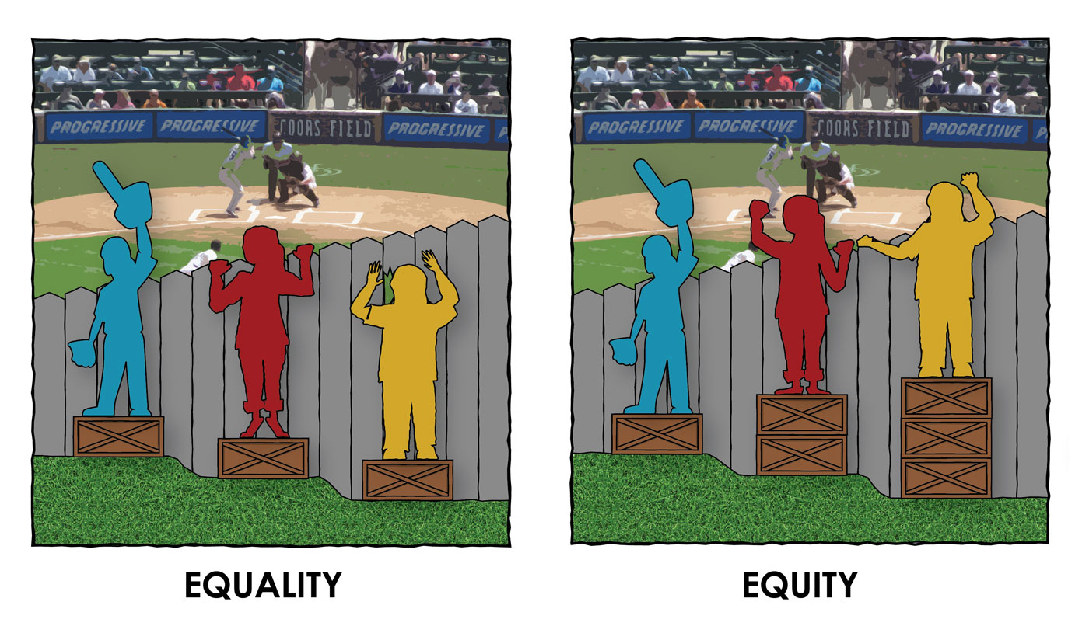
Equality vs. Equity

Slide 24
Pregnant and Parenting
Can’t discriminate against someone because of parenting, pregnancy, childbirth, false pregnancy, termination of pregnancy, or recovery of any of the aforementioned conditions
Must accommodate students missing class or assignments due to pregnancy or related conditions
Can’t discriminate against someone based on their parental status
Consult, consult, consult!

Slide 25
If someone misses or plans to miss classes or assignments because they are pregnant…
Inform your direct supervisor.
Contact Deputy Title IX Coordinators. They work with faculty to coordinate accommodations and support for students.

Slide 26
If you have concerns about students dealing with parenting constraints:
Inform your direct supervisor.
Contact Deputy Title IX Coordinators. They will provide consultation.

Slide 27
Case Study

Slide 28
Alex is pregnant
What should you do?
Alex messages you on Canvas in November and apologizes for “how she’s been lately”
She says she is pregnant, and it has been a lot more difficult than she thought which is why she “hasn’t been on her game”
She has missed 2 classes, a test, and is requesting an extension on a major paper
What questions do you have?
What accommodations should we make?

Slide 29
Do these details change your responses?
The student said the difficult part of the pregnancy is morning sickness
The student knew she was pregnant before registering for the class and was going to try to tough it out. She’s dropped the class in a previous semester.
The student has 6 kids and is already struggling
The student plagiarized a paper on the first assignment in the semester

Slide 30
Sexual misconduct accommodations…
What questions do you have?
David Tiscione calls you and informs you Peyton has been involved in a sexual misconduct case and needs academic accommodations.
It is April and the student has one test, a paper, and a final coming up.
The final is a group project, and the respondent is in the group
What accommodations should we make?

Slide 31
Do these details change your responses?
The incident involved the respondent telling the complainant that the complainant was pretty
The incident involved a violent sexual assault
The complainant has missed classes before the incident, is typically a student who does not seem to try hard
You know someone who has been through something similar and was a fantastic student

Slide 32
Gender identity

Slide 33
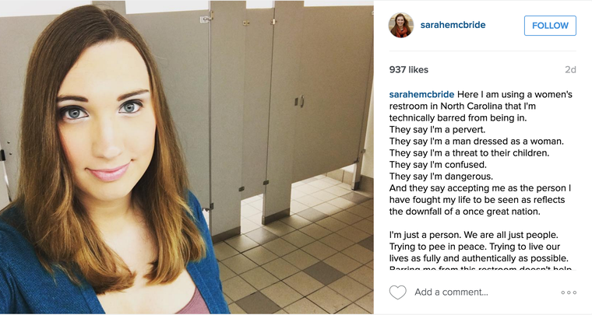
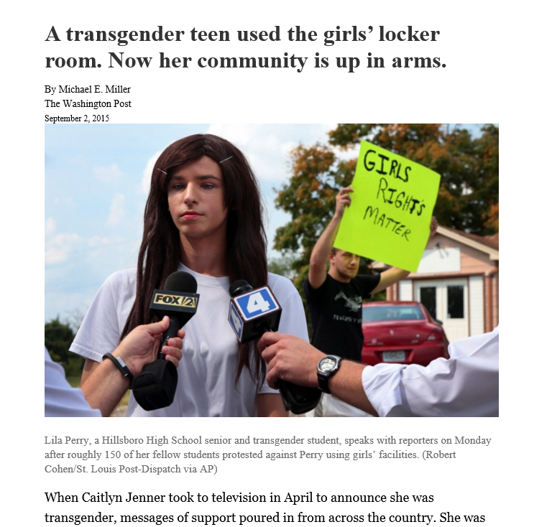
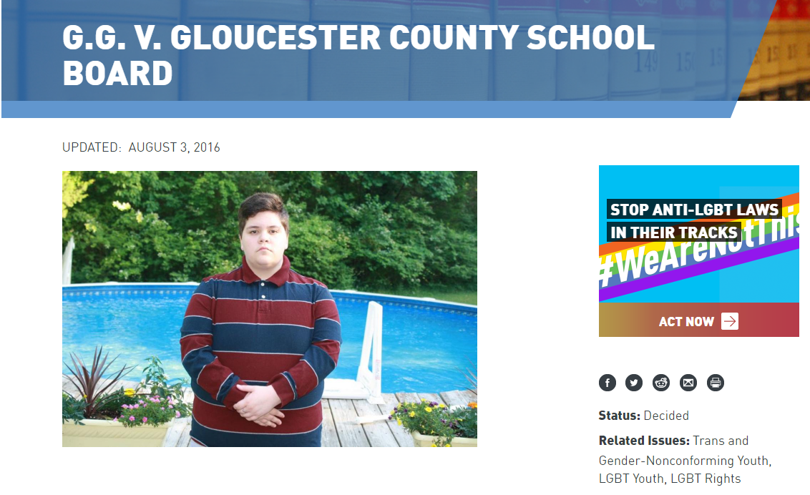
Notes:
JW

Slide 34
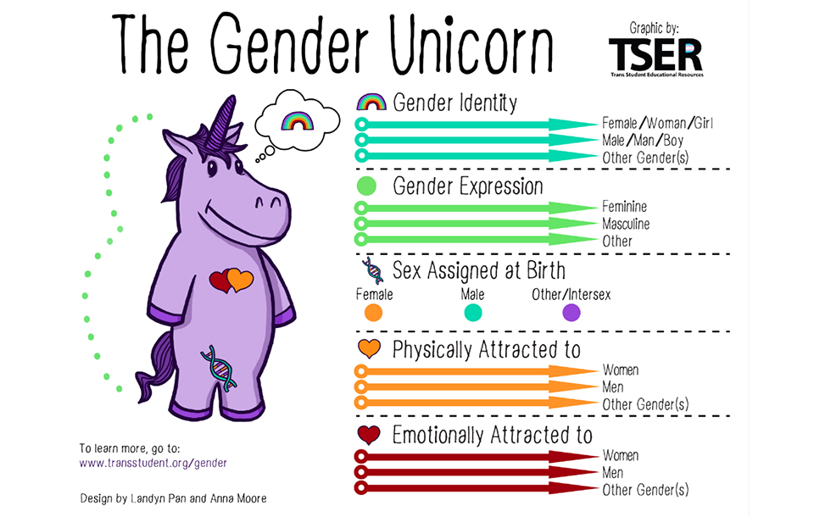

Slide 35
Gender Identity
“While the Department of Education’s Title IX regulations permit schools to provide sex-segregated restrooms, locker rooms, shower facilities, housing, athletic teams, and single-sex classes under certain circumstances, when a school elects to separate or treat students differently on the basis of sex in those situations, a school generally must treat transgender students consistent with their gender identity.”
Notes:
JW

Slide 36
Gender Identity in the classroom
Do not discriminate on the basis of a student’s gender (sex, gender identity, or expression
If they or HCC inform you of their gender or preferred name, refer to them as the gender or preferred name
Do not disclose information about their gender identity

Slide 37
Q+A

