Slide 1
Title IX Overview
Geoffrey Colbert
Senior Director, Athletics, Student Conduct and Executive Associate to the Vice President of Student Services

Slide 2
Overview
Definitions
Reporting options
Responsible Employee
Sexual misconduct process
Gender Identity
Q+A

Slide 3
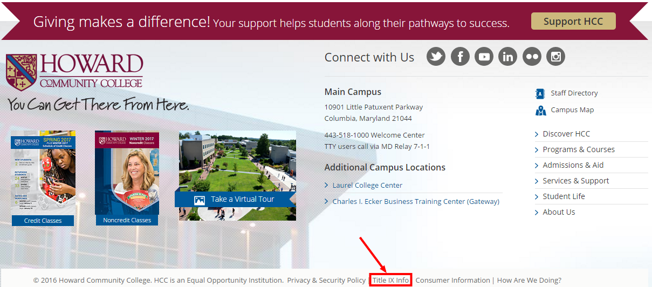

Slide 4
Sexual Harassment
Any unwelcome sexual advance, unwelcome request for sexual favors, or other unwelcome verbal or physical conduct of a sexual nature when:
Quid quo pro
Has the purpose or effect of unreasonably interfering with an individual’s work or academic performance

Slide 5
Sexual Assault
Any type of sexual contact or behavior that occurs without the explicit consent of the recipient
  Non-consensual sexual contact
    Touching of intimate body parts
  Non-consensual sexual intercourse
    Penetration

Slide 6
Consent
Permission to act through words or actions
Clear, voluntary, mutually understood, for each act
Active not passive
Given freely, no use of force or coercion
Knowingly, cannot be under 16 or incapacitated
Specific- permission for each activity
Notes:
Coercion is unreasonable pressure
Force is physical violence or threat of physical violence

Slide 7

(Western University)
Notes:
There are two pieces of information in our policy that were missing from this video- 1) Active not passive 2) Specific permission for each activity

Slide 8
Sexual exploitation
Taking non-consensual or abusive sexual advantage of another to benefit anyone other than the person being exploited

Slide 9
Dating/Domestic Violence
Violence or threat of violence between individuals:
  In a personal and private social relationship of a romantic or intimate nature
  Current or former spouse
  Person with whom a child is shared
  Person cohabitating

Slide 10
Stalking
Course of conduct that alarms or seriously annoys the person or makes them fear for their safety or that of family or friends
Includes cyber-stalking.
Intentionally following another person without their consent

Slide 11
What happens if sexual misconduct occurs?
Report it to HCC
  Any employee
  Public Safety
  Title IX Coordinators
Report it to police
Report it to both
Consult with confidential resources
Third party reporting

Slide 12
What does Title IX mean for you?
Staff/Faculty/ Student Leaders, etc… “responsible employee”
  Tell people you want to get them help, but let them know your responsibilities
  Student could believe you can do something about harassment
  Report information to supervisor and Title IX coordinator
Consult, consult, consult!
Notes:
Dave

Slide 13
Confidential resources
HCC Counseling Center or other counseling services
Hopeworks
Medical staff operating in a medical capacity

Slide 14
What happens if sexual misconduct occurs?
Interim Measures
HCC investigates
  Potentially meets with:
    Complainant
    Respondent
    Witnesses
Decision is made about whether policy is violated
Deliver outcome including sanctions
Appeal if necessary

Slide 15
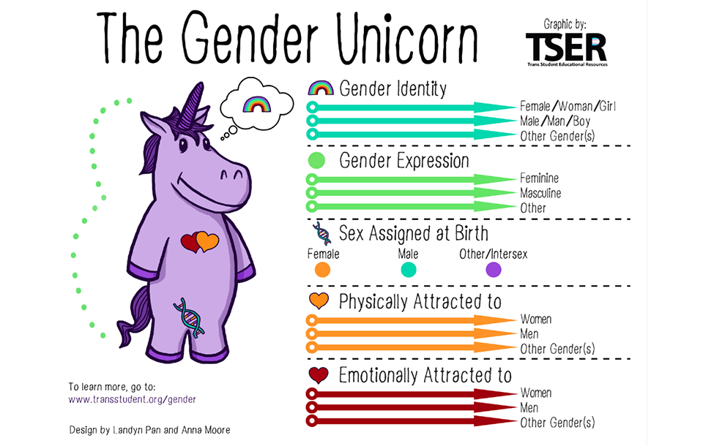

Slide 16
Gender Identity
For Title IX, sex=gender identity
“…a school generally must treat transgender students consistent with their gender identity”
Notes:
JW

Slide 17
Gender Identity at HCC
Do not discriminate on the basis of a student’s gender (sex, gender identity, or expression)
If they or HCC inform you of their gender or preferred name, refer to them as the gender or preferred name
Do not disclose information about their gender identity
HCC is working on policies and procedures related to gender identity including facilities and records

Slide 18
Bystander
Someone who is present at an event without participating in it
with the opportunity to participate or intervene
Active Bystander
Someone who is present at an event and
intervenes
Notes:
Merriam webster definition

Slide 19
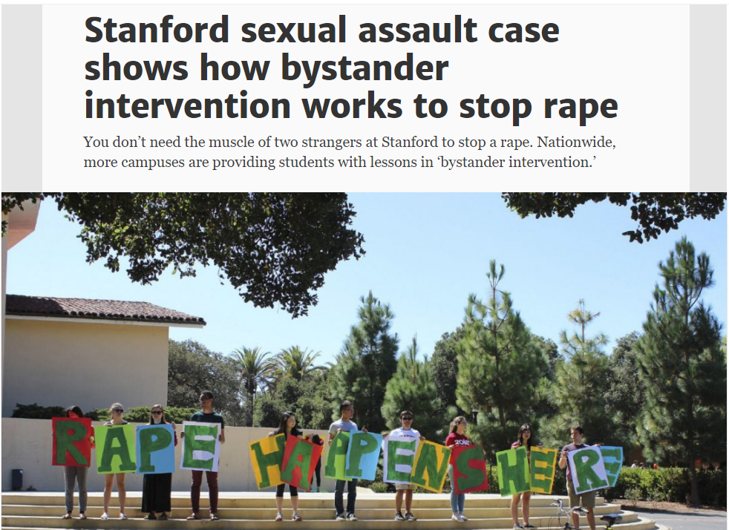
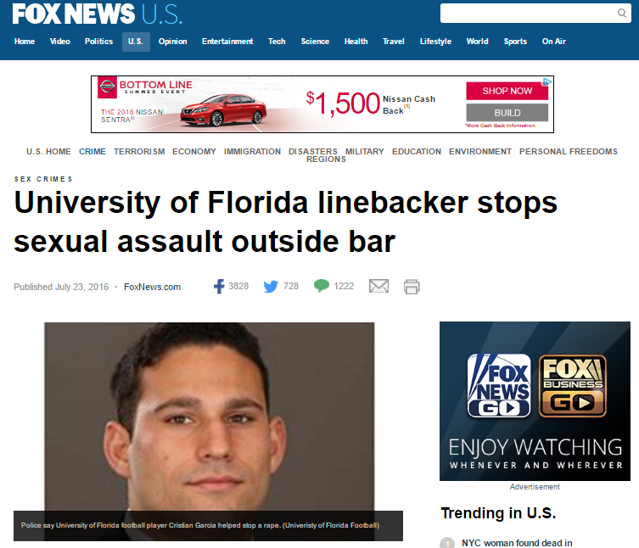
Bystander
Intervention
Notes:
Bystander intervention has been in the news recently around college campuses. Often these swooping in to save the day stories are what makes the news, and while these are awesome acts, they are not the main way to intervene and prevent harm.

Slide 20
What can you do to prevent sexual misconduct?
Notice the event
Interpret it as potentially a problem
Assume responsibility
Know how to help
Step up and help!
(Latane and Darley, 1968)
Notes:
The goal is to notice situations or events before they go to full blown, super hero level emergencies so the harm doesn’t get close to happening and to intervene in situations where they are emergencies
Notice the event- Two reasons people don’t notice the event- 1) Distractions like Pokemon Go or alcohol or bass 2) Don’t want to know because you’re busy. So, be aware of surroundings
Interpret as potentially a problem- Sometimes things are ambiguous or you might be looking to others to see if they think things are potentially a problem. There’s a famous study with smoke in a room and if there is one person and smoke fills the room, he’ll leave. But if smoke fills the room and there are multiple people not reacting like it’s a problem, he stays. Sometimes where there’s smoke there’s fire… sometimes it’s fog. If it looks like it could be, you have to go to the next step
Assume responsibility- There are barriers to intervening like our mood, thinking that someone else will do it, thinking it was their fault, not wanting to help people who are not like us. So, we have to be aware of those barriers and think, what would I want someone to do if that was me?
Know how to help, which I’ll go over in the next
Then lastly, step up and help!

Slide 21

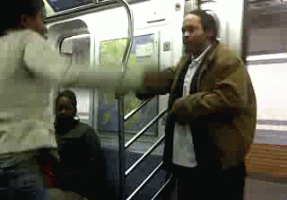
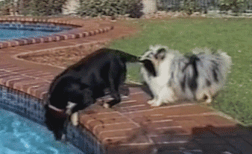
Know how to help…
Direct
Distract
Delegate
(Green Dot 2.0, 2014)
Notes:
Make sure to determine the safest way to intervene

Slide 22
Resources
Howardcc.edu/titleix
Student Handbook
Hopeworks
  www.wearehopeworks.org
Title IX Coordinators

Slide 23
Resources
Title IX Coordinators
  Dr. Cynthia Peterka
  Joseph Pettiford
Title IX Deputy Coordinators
  Geoffrey Colbert
  Christy Lee Koontz

Slide 24
Q+A

