Slide 1

HOWARD COMMUNITY COLLEGE
PATHWAYS TO TITLE IX AWARENESS
WHAT ARE THE POLICIES AND WHAT IS YOUR ROLE?
Zakia Reaves-Johnson,
Director of the Office of Student Rights & Responsibilities,
Title IX Deputy Coordinator
Executive Associate to the Provost
Interim Associate Vice President of Student Development & Social Support
Christy Koontz
Associate Director of the Office of Student Rights & Responsibilities
Title IX Deputy Coordinator

Slide 2
Welcome!
Howard Community College

Slide 3
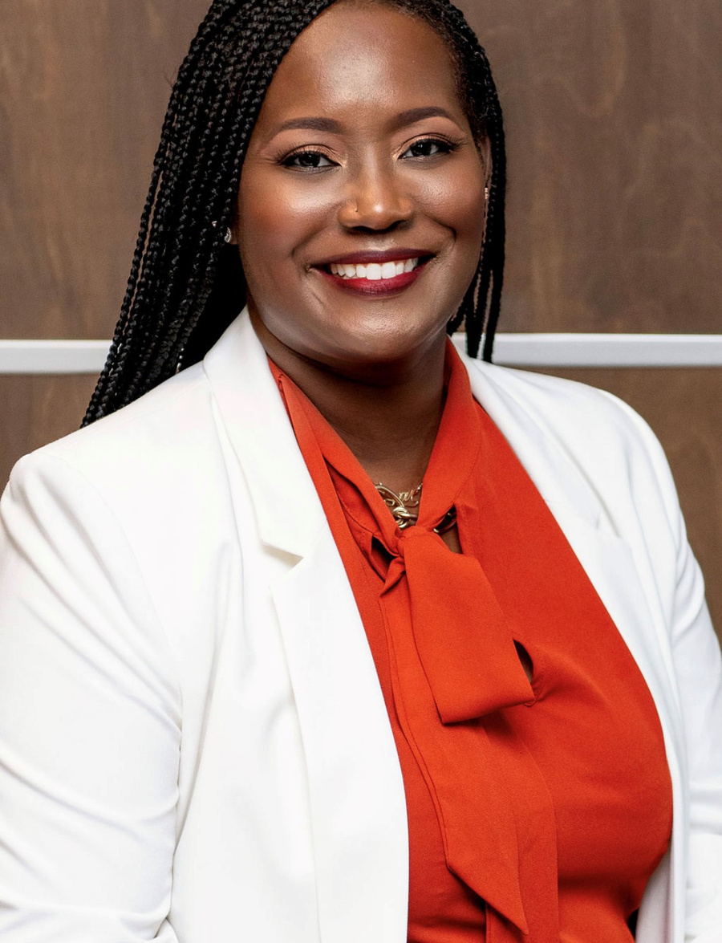
WHO AM I?
ZAKIA REAVES-JOHNSON
Zakia Reaves-Johnson is currently the Director of Student Conduct, Deputy Title IX Coordinator, and Executive Associate to the Vice President of Student Success at Howard Community College. Prior to this role, she served as the Interim Associate Vice President of Enrollment Services and before that the Director of Testing.
She first joined the HCC family in 2009, as a Counselor for the Student Support Service program where she provided transfer, career, and personal counseling to first-generation, students with disabilities, economically disadvantaged and at-risk students.
Zakia Johnson received a Bachelor’s degree in Criminal Justice and Master’s degree in Higher Education Administration & College Counseling from the University of Delaware. She is currently pursuing her doctoral degree in Higher Education with a concentration in Community College Leadership at Morgan State University.

Slide 4
Overview
  WHAT IS SEXUAL MISCONDUCT?
  HOW CAN WE PREVENT SEXUAL MISCONDUCT?
  WHAT ARE HCC'S SEXUAL MISCONDUCT POLICIES?
  WHAT ROLES DO TITLE IX COORDINATORS & TITLE IX DEPUTES PLAY?
  WHAT HAPPENS IF SEXUAL MISCONDUCT OCCURS AT HCC?
Howard Community College

Slide 5
Where does it happen?
  On college campuses--we know that 1 in 5 women will experience sexual assault.
  Before the age of 18, between 1 and 6 and 1 in 20 men will experience sexual abuse.
  Women have 1 in 3 chance of experiencing interpersonal violence in their lifetimes.

Slide 6
Where does it happen?
  1 in 4 men reported experiencing sexual violence in their lifetime.
  1 in 6 women and 1 in 19 men experience stalking.
  Sexual assault rates for LGBTQ individuals and people of color are equal to or higher than the general population
(Green Dot 2.0, 2014)

Slide 7

WHAT IS SEXUAL MISCONDUCT?
Title IX
No person in the United States shall, on the basis of sex, be excluded from participation in, be denied the benefits of, or be subjected to discrimination under any education program or activity receiving Federal financial assistance
(Title IX of the Education Amendments of 1972)
No

Slide 8

WHAT IS SEXUAL MISCONDUCT?
Title IX:
  Prohibits discrimination on the basis of sex
  Prohibits sexual misconduct and harassment
  Sex can include gender identity

Slide 9

TITLE IX REG UPDATES
  Clearly protect students and employees from all forms of sex discrimination
  Provide full protection from sex-based harassment.
  Protect the right of parents and guardians to support their elementary and secondary school children.

Slide 10
TITLE IX REG UPDATES
  Protect students and employees who are pregnant or have pregnancy-related conditions.
  Require schools to take prompt and effective action to end any sex discrimination in their education programs or activities – and to prevent its recurrence and remedy its effects.

Slide 11
TITLE IX REG UPDATES
  Require schools to respond promptly to all complaints of sex discrimination with a fair and reliable process that includes trained, unbiased decision makers to evaluate all permissible evidence.

Slide 12
TITLE IX REG UPDATES
  Protect LGBTQI+ students from discrimination based on sexual orientation, gender identity, and sex characteristics.

Slide 13
TITLE IX REG UPDATES
  Clarify and confirm protection from retaliation for students, employees, and others who exercise their Title IX rights.

Slide 14
TITLE IX REG UPDATES
  Improve the adaptability of the regulations’ grievance procedure requirements so that all recipients can implement Title IX’s promise of nondiscrimination fully and fairly in their educational environments.

Slide 15
TITLE IX REG UPDATES
  Improve the adaptability of the regulations’ grievance procedure requirements so that all recipients can implement Title IX’s promise of nondiscrimination fully and fairly in their educational environments.

Slide 16

SEXUAL HARRASSMENT
Any unwelcome sexual advance, unwelcome request for sexual favors, or other unwelcome verbal or physical conduct of a sexual nature when:
(1) Quid pro quo (favor for a favor)
(2) Has the purpose or effect of creating a hostile environment or unreasonably interfering with an individual’s work or academic performance

Slide 17

Verbal harassment or abuse
Pressure for sexual activity
Unwelcome touching
Quid pro quo (favor for a favor)
Displaying or sending explicit images or using explicit language
Threatening to commit a violation of sexual misconduct
EXAMPLES OF
SEXUAL
HARRASSMENT
Howard Community College

Slide 18
SEXUAL ASSAULT
Any type of sexual contact or behavior that occurs without the explicit consent of the recipient
  Incest
  Non-consensual sexual contact
    Touching of intimate body parts
  Non-consensual sexual intercourse
    Penetration

Slide 19
CONSENT
  Permission to act through words or actions
  Clear, voluntary, mutually understood, for each act
  Active not passive
  Given freely, no use of force or coercion
  Knowingly, cannot be under 16 or incapacitated
  Specific- permission for each activity

Slide 20

CONSENT

Slide 21

SEXUAL EXPLOITATION
Taking non-consensual or abusive sexual advantage of another to benefit anyone other than the person being exploited​

Slide 22
Sexual voyeurism​
Invading privacy​
Going beyond the boundaries of consent
(such as letting someone hide in a closet to watch you having consensual sex)​
Video or audio recording of sexual acts or private
activities without consent​
Sharing images without consent​
Knowingly exposing someone to a sexually transmitted
infection (STI) without their knowledge​
Administering drugs or alcohol to someone without
their knowledge ​
Exposing genitals without consent
SEXUAL
EXPLOITATION
Howard Community College

Slide 23
  Violence or threat of violence between individuals:​
    In a personal and private social relationship of a romantic or intimate nature​
    Current or former spouse​
    Person with whom a child is shared​
    Person cohabitating​
DATING/
DOMESTIC VIOLENCE
Howard Community College

Slide 24
Course of conduct that alarms or seriously annoys
the person or makes them fear for their safety or that
of family or friends​
Includes cyber-stalking
Intentionally following another person without their consent ​
STALKING
Howard Community College

Slide 25
  Repeated, unwanted/unsolicited contact​
    Face-to-face contact​
    Phone calls
    Voice messages​
    Text messages​
    Email​
    Social media use​
    Unwanted gifts​
  Repeatedly showing up or waiting outside a person’s home, classroom, place of employment, or vehicle​
STALKING
Howard Community College

Slide 26
WHAT HAPPENS IF SEXUAL MISCONDUCT OCCURS?
  Report it to HCC​
  Any employee​
  Public Safety​
  443-518-5555​
  443-518-5500​
  Title IX Coordinators​
  Report it to police​
  Report it to both​
  Consult with confidential resources​
  Third party reporting​
Howard Community College

Slide 27
CONFIDENTIAL RESOURCES
  HCC Counseling Center or other counseling services​
  Hopeworks​
  Medical staff operating in a medical capacity​
Howard Community College

Slide 28
  Interim Measures​
  Options to address formally or informally​
  Informal options​
    Continued interim measures​
    Conversation with student
WHAT HAPPENS IF SEXUAL MISCONDUCT OCCURS?​
Howard Community College

Slide 29
  Formal ​
    HCC investigates​
    Potentially meets with:​
      Complainant​
      Respondent​
      Witnesses​
    Determination if incident should go to
hearing or employee process​
    Hold hearing or employee process​
    Deliver outcome including sanctions​
    Appeal if necessary
WHAT HAPPENS IF SEXUAL MISCONDUCT OCCURS?​
Howard Community College

Slide 30
  Academic accommodations​
  Assistance in arranging for alternative college
employment arrangements or changing work schedules​
  A “no contact” order​
  Providing a public safety escort​
  Assistance identifying an advocate to help secure additional resources​
  Other measures the complainant would like to request​
INTERIM
MEASURES
Howard Community College

Slide 31
What is your role?

Slide 32
What role do you play?
All HCC employees are mandated reporters and are required to report any information they receive regarding sexual misconduct to their supervisor; HCC’s Title IX co-coordinators, Dr. Shantay Grays and Mr. Joseph Whalen; or HCC deputy Title IX coordinators, Ms. Zakia Reaves-Johnson and Ms. Christy Koontz. Incidents can also be reported to the Howard County Police Department. Students or staff may also direct questions about Title IX to the Department of Education’s Office of Civil Rights.

Slide 33
Someone who is present at an event with the opportunity to participate or intervene.
BYSTANDER
Howard Community College

Slide 34
Someone who is present at an event and​
intervenes​
ACTIVE
BYSTANDER
Howard Community College

Slide 35
  Notice the event​
  Interpret it as potentially a problem​
  Assume responsibility​
  Know how to help​
  Step up and help!
(Latane and Darley, 1968)
WHAT
CAN YOU DO TO PREVENT SEXUAL MISCONDUCT?
Howard Community College

Slide 36

DIRECT
Confront a situation. When safe, being direct is the most immediate way to intervene in a situation.
DISTRACT
Know How To Help
Perhaps you do not want to address a situation directly then you can try to cause a distraction that will diffuse the situation and give a moment for things to calm down.
DELEGATE
If you cannot intervene directly in something because there is a barrier that makes you uncomfortable, then enlist help. You do not have to do it alone.
Howard Community College

Slide 37
WHAT WOULD YOU DO?
You’re sitting in the café with a group of colleagues, and a man comes up to a woman in the group and says “I saw you walking across campus, and that a** is fine. Oh the things I would do”​
  Direct: Tell the man to knock it off.​
  Direct: Ask the woman if she is comfortable with the comments.​
  Delegate: Ask the man’s friends to get the man to stop​
  Distract: Say “XXXX that test I just had was so hard.”​
Howard Community College

Slide 38
WHAT WOULD YOU DO?
​You’re walking across the quad, and you see a couple arguing. One person is cornering their partner by Duncan Hall, yelling and not letting them leave.​
​
  Direct: Go up to the couple and ask if everything is okay.​
  Delegate: Get your more confident, stronger friend to go up and intervene.​
  Delegate: Call public safety.​
  Distract: Walk by them, trip and drop your books.​
  Distract: Walk up and ask them where the library is​
Howard Community College

Slide 39
Resources
  Howardcc.edu/titleix​
  Student Handbook​
  HopeWorks (Howard County Domestic Violence Center) – 410-997-2272
  www.wearehopeworks.org​
  Title IX Coordinators​

Slide 40
Resources
  HCC Counseling Center – 443-518-1340
  HCC Human Resources – 443-518-1100
  HCC Public Safety – 443-518-5550
  HCC Student Success – 443-518-4809
  HCC Wellness Center – 443-518-4950
  Employee Assistance program – 800-327-2251

Slide 41
What role do we play?
The Title IX Coordinator and the Deputy Coordinators work to resolve complaints of sexual misconduct, sexual harassment, and gender-related violence, including stalking and intimate partner violence involving students and employees at HCC.

Slide 42
Resources
  Title IX Coordinators​
    Dr. Shantay Grays
    Mr. Joseph Whalen
  Title IX Deputy Coordinators​
    Ms. Zakia Reaves-Johnson
    Ms. Christy Koontz

Slide 43


OUR CONTACT INFO
ZAKIA REAVES-JOHNSON
Email | zjohnson@howardcc.edu
Phone Number | 443.518.4079
CHRISTY KOONTZ
Email | ckoontz@howardcc.edu
Phone Number | 443.518.3182
Howard Community College

Slide 44
Here's to a
Successful & Safe
Year!
Howard Community College

