Slide 1
Sexual Misconduct and Pregnancy: Process and accommodations
Llatetra Esters
Director of Student Conduct and Executive Associate to VPSS
David Tiscione
Associate Director of Student Conduct and Compliance, Title IX Deputy
Notes:
Might need to get the keys to this for Super Bowl Sunday!

Slide 2
Overview
Philosophy behind Title IX
Refresher on policies
Discussion about accommodations
Case study
Q+A

Slide 3
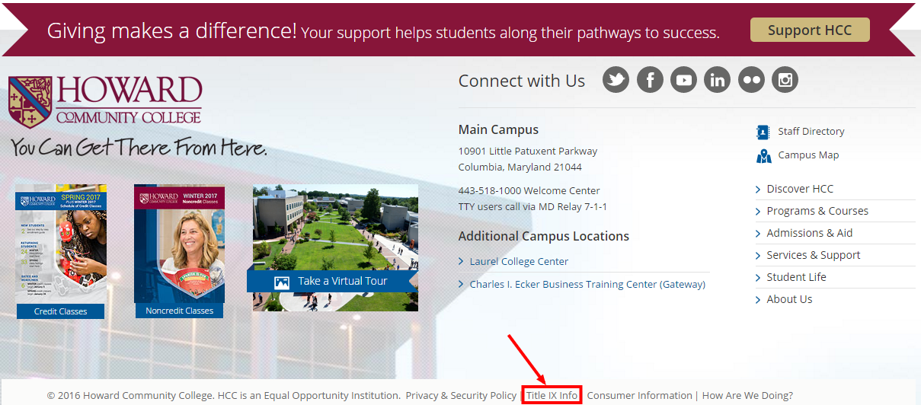

Slide 4
What Is Title IX?
“No person in the United States shall, on the basis of sex, be excluded from participation in, be denied the benefits of, or be subjected to discrimination under any education program or activity receiving Federal financial assistance.”
- Title IX of the Education Amendments of 1972
Notes:
JW

Slide 5
What is sexual misconduct?
Title IX:
Prohibits discrimination on the basis of sex
Prohibits sexual misconduct and harassment
Sex can include gender identity
Prohibits discrimination based on pregnancy and parenting
Includes any educational activity and any community member
Admissions, Recruitment, Financial Aid, Academic Programs, Student Treatment and Services, Counseling and Guidance, Discipline, Classroom Assignment, Grading, Vocational Education, Recreation, Physical Education, Athletics, Housing, Employment, and …

Slide 6
These situations can be challenging for faculty…
Following policies and procedures
Desire to be fair to all students
Training and knowledge base may be minimal
Others?

Slide 7
Why do we do this work?
Prevent sex discrimination
When sexual misconduct happens, we want to stop the behavior, prevent its reoccurrence, and address its effects
Keep the student whole
Allow the participants in the process to feel heard and fairly treated
Compliance

Slide 8
What happens if sexual misconduct occurs?
Report it to HCC
Any non confidential employee
Public Safety
Title IX Coordinators
Report it to police
Report it to both
Consult with confidential resources
Third party reporting

Slide 9
Responsible employees vs. confidential resources
All non confidential employees are “responsible employees”.
Student could believe the employee can do something about harassment
They should:
Tell people they want to get them help, but let them know their responsibilities
If students want to remain confidential or consider options, consult with counseling
Report information to supervisor and Title IX coordinator
Notes:
Dave

Slide 10
Confidential resources
HCC Counseling Center or other counseling services
Hopeworks
Medical staff operating in a medical capacity

Slide 11
Types of Sexual Misconduct
Sexual Harassment
Sexual Assault
Incest
Non-consensual Sexual Intercourse
Non-consensual Sexual Contact
*Consent
Sexual Exploitation
Dating/Domestic Violence
Stalking
Notes:
Sexual Harassment- Any unwelcome sexual advance, unwelcome request for sexual favors, or other unwelcome verbal or physical conduct of a sexual nature when:
Quid quo pro
Has the purpose or effect of creating a hostile environment which unreasonably interfering with an individual’s work or academic performance
Sexual Assault- Any type of sexual contact or behavior that occurs without the explicit consent of the recipient
Non-consensual sexual contact
Touching of intimate body parts
Non-consensual sexual intercourse
Penetration
Consent
Permission to act through words or actions
Clear, voluntary, mutually understood, for each act
Active not passive
Given freely, no use of force or coercion
Knowingly, cannot be under 16 or incapacitated
Specific- permission for each activity
Sexual Exploitation- Taking non-consensual or abusive sexual advantage of another to benefit anyone other than the person being exploited
Stalking- course of conduct that causes fear

Slide 12
What happens if sexual misconduct occurs?
Interim Measures
Options to address formally or informally
Informal options
Continued interim measures
Conversation with student
Formal
HCC investigates
Potentially meets with:
Complainant
Respondent
Witnesses
Determination if incident should go to hearing or employee process
Hold hearing or employee process
Deliver outcome including sanctions
Appeal if necessary

Slide 13
Interim Measures
Academic accommodations
Assistance in arranging for alternative college employment arrangements or changing work schedules
A “no contact” order
Providing a public safety escort
Assistance identifying an advocate to help secure additional resources
Other measures the complainant would like to request
Notes:
Interim measures are those services, accommodations, or other assistance that the college puts in place to support complainant

Slide 14
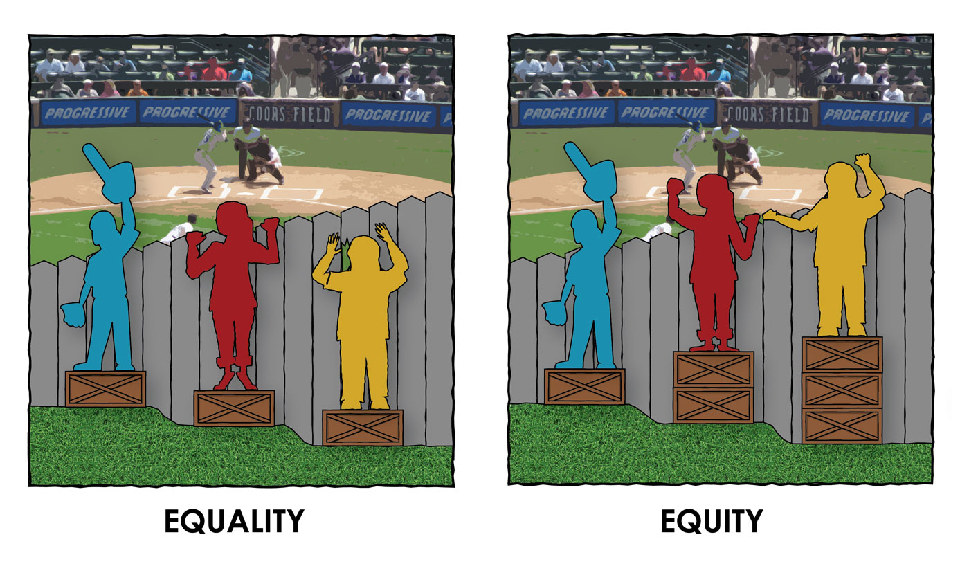
Equality vs. Equity

Slide 15
Pregnant and Parenting
Can’t discriminate against someone because of parenting, pregnancy, childbirth, false pregnancy, termination of pregnancy, or recovery of any of the aforementioned conditions
Must accommodate students missing class or assignments due to pregnancy or related conditions
Can’t discriminate against someone based on their parental status
Consult, consult, consult!

Slide 16
If someone misses or plans to miss classes or assignments because they are pregnant…
Inform your direct supervisor.
Contact Deputy Title IX Coordinators. They work with faculty to coordinate accommodations and support for students.

Slide 17
If you have concerns about students dealing with parenting constraints:
Inform your direct supervisor.
Contact Deputy Title IX Coordinators. They will provide consultation.

Slide 18
Case Study

Slide 19
Alex is pregnant
What should you do?
Alex messages you on Canvas in November and apologizes for “how she’s been lately”
She says she is pregnant, and it has been a lot more difficult than she thought which is why she “hasn’t been on her game”
She has missed 2 classes, a test, and is requesting an extension on a major paper
What questions do you have?
What accommodations should we make?

Slide 20
Do these details change your responses?
The student said the difficult part of the pregnancy is morning sickness
The student knew she was pregnant before registering for the class and was going to try to tough it out. She’s dropped the class in a previous semester.
The student has 6 kids and is already struggling
The student plagiarized a paper on the first assignment in the semester

Slide 21
Sexual misconduct accommodations…
What questions do you have?
David Tiscione calls you and informs you Peyton has been involved in a sexual misconduct case and needs academic accommodations.
It is April and the student has one test, a paper, and a final coming up.
The final is a group project, and the respondent is in the group
What accommodations should we make?

Slide 22
Do these details change your responses?
The incident involved the respondent telling the complainant that the complainant was pretty
The incident involved a violent sexual assault
The complainant has missed classes before the incident, is typically a student who does not seem to try hard
You know someone who has been through something similar and was a fantastic student

Slide 23
Q+A

