Slide 1
Preventing Sexual Misconduct at HCC: What are the policies and what is your role?
David Tiscione
Associate Director of Student Conduct and Compliance, Title IX Deputy
Notes:
Might need to get the keys to this for Super Bowl Sunday!

Slide 2
Overview
What is sexual misconduct?
What are HCC’s sexual misconduct policies?
What happens if sexual misconduct occurs at HCC?
How can we prevent sexual misconduct?
Notes:
Why are we talking about this in orientation? 1) we think it’s important for you to know because it introduces you to our values and norms that sexual misconduct is something we discuss and will not accept and 2) armed w/ this information we can make the campus safer
Sexual misconduct can be a difficult subject to discuss, so please make sure to take care of yourself. If you need to seek out resources to process this information, please let a staff person know.

Slide 3
Where does this happen?
On college campuses – we know that 1 in 5 women will experience sexual assault.
Before the age of 18, between 1 in 6 and 1 in 20 boys will experience sexual abuse.
Women have a 1 in 3 chance of experiencing interpersonal violence in their lifetimes.
1 in 4 men reported experiencing sexual violence in their lifetime.
1 in 6 women and 1 in 19 men experience stalking
Sexual assault rates for LGBTQ individuals and people of color are equal to or higher than the general population
(Green Dot 2.0, 2014)
Notes:
These sobering stats show two things- 1) They show that sexual violence happens nationwide and that it is prevalent on college campuses 2) They show that sexual violence can happen to anyone including women, men, people of color, and those in the LGBTQ community

Slide 4
What is sexual misconduct?
Title IX:
No person in the United States shall, on the basis of sex, be excluded from participation in, be denied the benefits of, or be subjected to discrimination under any education program or activity receiving Federal financial assistance
(Title IX of the Education Amendments of 1972)

Slide 5
What is sexual misconduct?
Title IX:
Prohibits discrimination on the basis of sex
Prohibits sexual misconduct and harassment
Sex can include gender identity

Slide 6
What is sexual misconduct?
Sexual Harassment
Sexual Assault
Sexual Exploitation
Dating/Domestic Violence
Stalking
Notes:
At HCC, our mission is providing pathways to success. We believe that sexual violence is an issue we take very seriously because of the drastic effects it can have on all of those involved including the victims or survivors, the responding party, and each of their friends and families. Further, we are required by the federal government to address these issues. Our Sexual Misconduct policy outlines all of the behaviors that are prohibited for employees of HCC and for you as a student and the policies we will follow if a violation is reported. I’m going to take you through a few of the more prominent definitions and processes, but please be sure to review our handbook for a more comprehensive overview of the policy.

Slide 7
Sexual Harassment
Any unwelcome sexual advance, unwelcome request for sexual favors, or other unwelcome verbal or physical conduct of a sexual nature when:
Quid pro quo
Has the purpose or effect of creating a hostile environment or unreasonably interfering with an individual’s work or academic performance

Slide 8
Examples of Sexual Harassment
Verbal harassment or abuse
Pressure for sexual activity
Unwelcome touching
Quid pro quo
Displaying or sending explicit images or using explicit language
Threatening to commit a violation of sexual misconduct

Slide 9
Sexual Assault
Any type of sexual contact or behavior that occurs without the explicit consent of the recipient
Incest
Non-consensual sexual contact
Touching of intimate body parts
Non-consensual sexual intercourse
Penetration

Slide 10
Consent
Permission to act through words or actions
Clear, voluntary, mutually understood, for each act
Active not passive
Given freely, no use of force or coercion
Knowingly, cannot be under 16 or incapacitated
Specific- permission for each activity
Notes:
Coercion is unreasonable pressure
Force is physical violence or threat of physical violence
The idea is that when we talk about consent “in the bedroom”, as a society we create a lot of gray areas and questions. But if we talk about consent with an activity in day to day life, we can learn more about what consent looks like.

Slide 11

(Adapted from Western University)
Notes:
While this has some funny innuendos, it’s important to note this can be hurtful for some because they’ve experienced these situations and excuses.
Once again, this just goes to show we don’t get concerned about gray areas and the “what ifs” in day to day situations, so we should be able to do the same when we talk about consent and sex

Slide 12
Sexual exploitation
Taking non-consensual or abusive sexual advantage of another to benefit anyone other than the person being exploited

Slide 13
Sexual exploitation
Sexual voyeurism
Invading privacy
Going beyond the boundaries of consent (such as letting someone hide in a closet to watch you having consensual sex)
Video or audio recording of sexual acts or private activities without consent
Sharing images without consent
Knowingly exposing someone to a sexually transmitted infection (STI) without their knowledge
Administering drugs or alcohol to someone without their knowledge
Exposing genitals without consent
Notes:
Such as finding someone’s phone and looking through their images
Sharing images without consent- Rob Kardashian

Slide 14
Dating/Domestic Violence
Violence or threat of violence between individuals:
In a personal and private social relationship of a romantic or intimate nature
current or former spouse
Person with whom a child is shared
Person cohabitating

Slide 15
Stalking
Course of conduct that alarms or seriously annoys the person or makes them fear for their safety or that of family or friends
Includes cyber-stalking.
Intentionally following another person without their consent
Notes:
Different than the stalking that’s come to be used in day to day conversation… not like your auntie “stalking you” on facebook by liking and commenting on everything. My mom did that year in review thing on facebook, and she liked 21,685 things.

Slide 16
Stalking
Repeated, unwanted/unsolicited contact
Face-to-face contact
Phone calls
Voice messages
Text messages
Email
Social media use
Unwanted gifts
Repeatedly showing up or waiting outside a person’s home, classroom, place of employment, or vehicle

Slide 17
What happens if sexual misconduct occurs?
Report it to HCC
Any employee
Public Safety
443-518-5555
443-518-5500
Title IX Coordinators
Report it to police
Report it to both
Consult with confidential resources
Third party reporting
Notes:
These are crimes or incidents motivated by power where power to choose is taken away from the complainant, so we make our process based around giving options to students to give power back

Slide 18
Confidential resources
HCC Counseling Center or other counseling services
Hopeworks
Medical staff operating in a medical capacity

Slide 19
What happens if sexual misconduct occurs?
Interim Measures
Options to address formally or informally
Informal options
Continued interim measures
Conversation with student
Formal
HCC investigates
Potentially meets with:
Complainant
Respondent
Witnesses
Determination if incident should go to hearing or employee process
Hold hearing or employee process
Deliver outcome including sanctions
Appeal if necessary
Notes:
There are times when there is a threat to individuals or the campus where we may need to go through a formal process
We prevent retaliation
We have an amnesty policy for someone who is a witness or is reporting sexual misconduct

Slide 20
Interim Measures
Academic accommodations
Assistance in arranging for alternative college employment arrangements or changing work schedules
A “no contact” order
Providing a public safety escort
Assistance identifying an advocate to help secure additional resources
Other measures the complainant would like to request
Notes:
Interim measures are those services, accommodations, or other assistance that the college puts in place to support complainant

Slide 21
What is your role?
Notes:
As part of providing pathways to success, we want our community to be free of sexual misconduct and harassment. We believe the community and specifically students can assist with this by being active bystanders and intervening in situations that could cause harm

Slide 22
Bystander
Someone who is present at an event without participating in it
with the opportunity to participate or intervene
Active Bystander
Someone who is present at an event and
intervenes
Notes:
Merriam webster definition

Slide 23
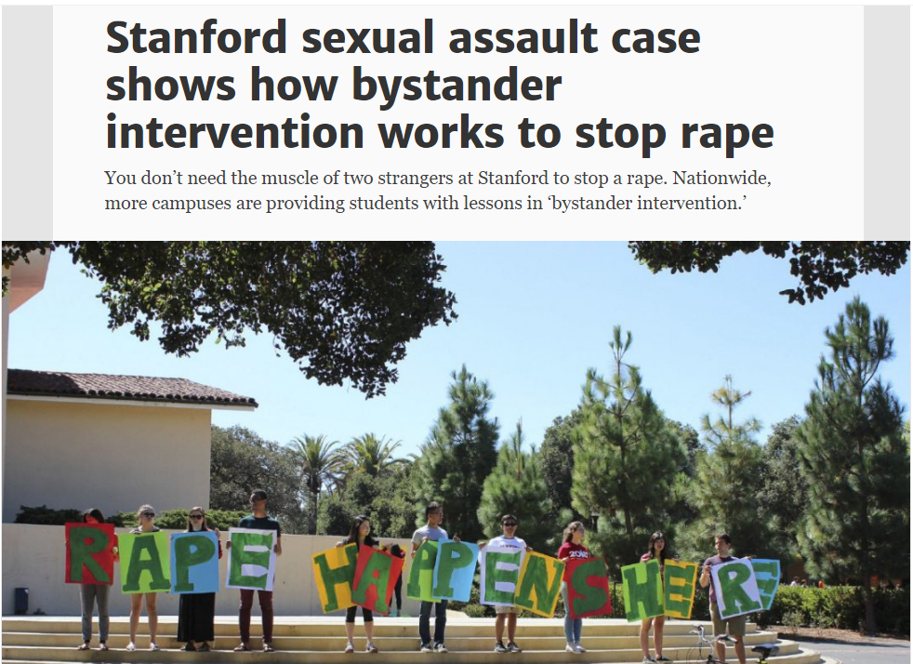
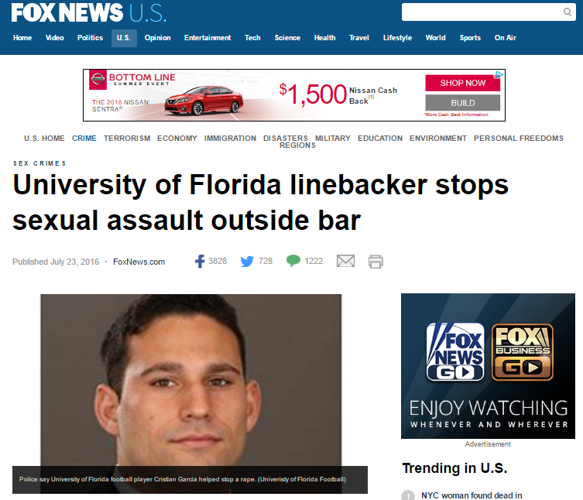
Bystander
Intervention
Notes:
Bystander intervention has been in the news recently around college campuses. Often these swooping in to save the day stories are what makes the news, and while these are awesome acts, they are not the main way to intervene and prevent harm.

Slide 24
What can you do to prevent sexual misconduct?
Notice the event
Interpret it as potentially a problem
Assume responsibility
Know how to help
Step up and help!
(Latane and Darley, 1968)
Notes:
The goal is to notice situations or events before they go to full blown, super hero level emergencies so the harm doesn’t get close to happening and to intervene in situations where they are emergencies
Notice the event- Two reasons people don’t notice the event- 1) Distractions like alcohol or bass 2) Don’t want to know because you’re busy. So, be aware of surroundings
Interpret as potentially a problem- Sometimes things are ambiguous or you might be looking to others to see if they think things are potentially a problem. There’s a famous study with smoke in a room and if there is one person and smoke fills the room, he’ll leave. But if smoke fills the room and there are multiple people not reacting like it’s a problem, he stays. Sometimes where there’s smoke there’s fire… sometimes it’s fog. If it looks like it could be, you have to go to the next step
Assume responsibility- There are barriers to intervening like our mood, thinking that someone else will do it, thinking it was their fault, not wanting to help people who are not like us. So, we have to be aware of those barriers and think, what would I want someone to do if that was me?
Know how to help, which I’ll go over in the next
Then lastly, step up and help!

Slide 25
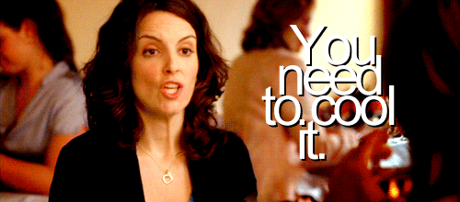
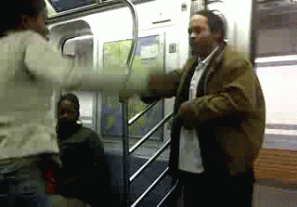
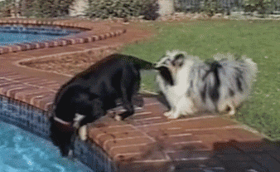
Know how to help…
Direct
Distract
Delegate
(Green Dot 2.0, 2014)
Notes:
Tina fey
Make sure to determine the safest way to intervene
This changes culture- people will be less likely to do something because they know it’s not tolerated and people will feel more comfortable intervening because they see it works

Slide 26
What would you do?
You’re sitting in the café with a group of friends, and a man comes up to a woman in the group and says “I saw you walking across campus, and that ass is fine. Oh the things I would do”
Direct: Tell the man to knock it off.
Direct: Ask the woman if she is comfortable with the comments.
Delegate: Ask the man’s friends to get the man to stop
Distract: Say “Ermahgerd that test I just had was so hard.”

Slide 27
What would you do?
You’re walking across the quad, and you see a couple arguing. One person is cornering their partner by Duncan hall, yelling and not letting them leave.
Direct: Go up to the couple and ask if everything is okay.
Delegate: Get your more confident, stronger friend to go up and intervene.
Delegate: Call public safety.
Distract: Walk by them, trip and drop your books.
Distract: Walk up and ask them where the library is

Slide 28
Resources
Howardcc.edu/titleix
Student Handbook
Hopeworks
www.wearehopeworks.org
Title IX Coordinators

Slide 29
Resources
Title IX Coordinators
Dr. Cynthia Peterka
David Jordan
Title IX Deputy Coordinators
Dr. Llatetra Esters
David Tiscione

Slide 30
My contact information
David Tiscione
443-518-4809
dtiscione@howardcc.edu

