Slide 1
2018 Title IX Training for HCC Public Safety Staff
Presented by
Dave Tiscione
Associate director of student conduct and compliance, title ix deputy
Notes:
JW

Slide 2
Overview of Presentation
What is Title IX?
Important Definitions
What does Title IX mean for you?
Other information you need to know
Questions & Answers
Notes:
JW

Slide 3
Before We Get Started
What do YOU know about Title IX?
Notes:
JW

Slide 4
Which of these is covered under Title IX?
Admissions and recruitment
Academic programs
Counseling
Student conduct
Notes:
JW

Slide 5
Which of these is covered under Title IX?
Athletics
Grading
Employment
Assignments
Notes:
JW

Slide 6
Programs and Activities Covered By Title IX
Includes, but not limited to: Admissions, Recruitment, Financial Aid, Academic Programs, Student Treatment and Services, Counseling and Guidance, Discipline, Classroom Assignment, Grading, Vocational Education, Recreation, Physical Education, Athletics, Housing, Employment, and …
Retaliation
On and off campus
Notes:
JW

Slide 7
What is sexual misconduct?
Title IX:
No person in the United States shall, on the basis of sex, be excluded from participation in, be denied the benefits of, or be subjected to discrimination under any education program or activity receiving Federal financial assistance
(Title IX of the Education Amendments of 1972)

Slide 8
What is sexual misconduct?
Title IX:
Prohibits discrimination on the basis of sex
Prohibits sexual misconduct and harassment
Sex can include gender identity

Slide 9
What is sexual misconduct?
Sexual Harassment
Sexual Assault
Sexual Exploitation
Dating/Domestic Violence
Stalking
Notes:
At HCC, our mission is providing pathways to success. We believe that sexual violence is an issue we take very seriously because of the drastic effects it can have on all of those involved including the victims or survivors, the responding party, and each of their friends and families. Further, we are required by the federal government to address these issues. Our Sexual Misconduct policy outlines all of the behaviors that are prohibited for employees of HCC and for you as a student and the policies we will follow if a violation is reported. I’m going to take you through a few of the more prominent definitions and processes, but please be sure to review our handbook for a more comprehensive overview of the policy.

Slide 10
Sexual Harassment
Any unwelcome sexual advance, unwelcome request for sexual favors, or other unwelcome verbal or physical conduct of a sexual nature when:
Quid pro quo
Has the purpose or effect of creating a hostile environment or unreasonably interfering with an individual’s work or academic performance

Slide 11
Examples of Sexual Harassment
Verbal harassment or abuse
Pressure for sexual activity
Unwelcome touching
Quid pro quo
Displaying or sending explicit images or using explicit language
Threatening to commit a violation of sexual misconduct

Slide 12
Sexual Assault
Any type of sexual contact or behavior that occurs without the explicit consent of the recipient
Incest
Non-consensual sexual contact
Touching of intimate body parts
Non-consensual sexual intercourse
Penetration

Slide 13
Consent
Permission to act through words or actions
Clear, voluntary, mutually understood, for each act
Active not passive
Given freely, no use of force or coercion
Knowingly, cannot be under 16 or incapacitated
Specific- permission for each activity
Notes:
Coercion is unreasonable pressure
Force is physical violence or threat of physical violence
The idea is that when we talk about consent “in the bedroom”, as a society we create a lot of gray areas and questions. But if we talk about consent with an activity in day to day life, we can learn more about what consent looks like.

Slide 14
Sexual exploitation
Taking non-consensual or abusive sexual advantage of another to benefit anyone other than the person being exploited

Slide 15
Sexual exploitation
Sexual voyeurism
Invading privacy
Going beyond the boundaries of consent (such as letting someone hide in a closet to watch you having consensual sex)
Video or audio recording of sexual acts or private activities without consent
Sharing images without consent
Knowingly exposing someone to a sexually transmitted infection (STI) without their knowledge
Administering drugs or alcohol to someone without their knowledge
Exposing genitals without consent
Notes:
Such as finding someone’s phone and looking through their images
Sharing images without consent- Rob Kardashian

Slide 16
Dating/Domestic Violence
Violence or threat of violence between individuals:
In a personal and private social relationship of a romantic or intimate nature
current or former spouse
Person with whom a child is shared
Person cohabitating

Slide 17
Stalking
Course of conduct that alarms or seriously annoys the person or makes them fear for their safety or that of family or friends
Includes cyber-stalking.
Intentionally following another person without their consent
Notes:
Different than the stalking that’s come to be used in day to day conversation… not like your auntie “stalking you” on facebook by liking and commenting on everything. My mom did that year in review thing on facebook, and she liked 21,685 things.

Slide 18
Stalking
Repeated, unwanted/unsolicited contact
Face-to-face contact
Phone calls
Voice messages
Text messages
Email
Social media use
Unwanted gifts
Repeatedly showing up or waiting outside a person’s home, classroom, place of employment, or vehicle

Slide 19

IS
IT
Title IX/
Sexual Misconduct?

Slide 20

A woman reports another woman in her class says things that make her feel uncomfortable. She says the woman says things like “mmm you’re a snack”

Slide 21

A man and a woman who do not know each other get into an argument in the parking lot. The man pushes the woman as he storms away from the argument.

Slide 22

A couple is arguing on the quad, the woman slaps the man because he cheated on her.

Slide 23
A man says another man keeps contacting him and off campus it makes him feel uncomfortable. He has seen him at the mall, the bus stop, and the man has messaged him on multiple social media platforms.

Slide 24
A woman says he was working out at the gym and a man walked by and patted her on the rear and said “good game”.

Slide 25
What happens if sexual misconduct occurs?
Report it to HCC
Any employee
Public Safety
443-518-5555
443-518-5500
Title IX Coordinators
Report it to police
Report it to both
Consult with confidential resources
Third party reporting
Notes:
These are crimes or incidents motivated by power where power to choose is taken away from the complainant, so we make our process based around giving options to students to give power back

Slide 26
Confidential resources
HCC Counseling Center or other counseling services
Hopeworks
Medical staff operating in a medical capacity

Slide 27
What happens if sexual misconduct occurs?
Interim Measures
Options to address formally or informally
Informal options
Continued interim measures
Conversation with student
Formal
HCC investigates
Potentially meets with:
Complainant
Respondent
Witnesses
Determination if incident should go to hearing or employee process
Hold hearing or employee process
Deliver outcome including sanctions
Appeal if necessary
Notes:
There are times when there is a threat to individuals or the campus where we may need to go through a formal process
We prevent retaliation
We have an amnesty policy for someone who is a witness or is reporting sexual misconduct

Slide 28
Interim Measures
Academic accommodations
Assistance in arranging for alternative college employment arrangements or changing work schedules
A “no contact” order
Providing a public safety escort
Assistance identifying an advocate to help secure additional resources
Other measures the complainant would like to request
Notes:
Interim measures are those services, accommodations, or other assistance that the college puts in place to support complainant

Slide 29
Initial interaction with complainant as responsible employee
Notify them:
You want to hear what they have to tell you
You want to help and support them
You are a responsible employee
You need to share any information about sexual misconduct with the Title IX team
You want them to have options for next steps
They can speak with a confidential resource or
They could continue speaking with youWhat would you like to do?

Slide 30
Interacting with Complainant
Show empathy
Believe them
Say things like “I’m sorry this happened to you”
Remember everyone deals with trauma differently
Avoid showing doubt
Do not victim blame; avoid why questions
Only promise our process
Offer confidential resources

Slide 31
Interacting with Complainant
Trauma informed
Complainant may have experienced trauma
Science of the brain may affect actions in the moment of sexual violence and memory afterward
Memory is not linear, may remember peripheral details which can help recall memories

Slide 32
Initial interaction with respondent as responsible employee
Inform them:
You want to hear what they have to tell you
You want to help and support them
You are a responsible employee
You need to share any information about sexual misconduct with the Title IX team
They can speak with a confidential resource or
They could continue speaking with you
What would you like to do?

Slide 33
Interacting with Respondent
Show empathy
Believe them
This sounds like it is difficult to deal with
This sounds like a stressful situation
Only promise the process
Explain that someone from student services may reach out
Offer counseling services

Slide 34
Your role in receiving sexual misconduct reports
Follow
The
policy
Things to remember
-Try to have Title IX staff respond if they are available
-Do not make contact with the respondent unless there is an immediate danger
-Provide complainant with options using public safety title ix response
-Communicate with your supervisory structure to ensure proper protocol and clery requirements
-Offer complainant to write a statement
Consult
When
unsure

Slide 35
Protocol
Emergency and non-emergency incidents
Emergency may require Clery notifications
Non-emergency may not
Call Title IX or Evening/Weekend administrators
If unavailable, public safety coordinates response

Slide 36
Case Study

Slide 37
Taylor
Taylor comes to public safety and you are the person responding. Taylor says…
“Hey, how’s it going? So, ummm… I’ve been dealing with some difficult stuff lately, and I was wondering if I could talk with you about it…”

Slide 38
Complainant
Taylor says
“There’s this guy who keeps following me. We share a class together, and on breaks he follows me to the candy machines. He talked to me once and said I was attractive, which creeped me out. He seems like he’s everywhere I am on campus. Sometimes I see him in the library and café, and he always seems to be getting to class around the same time as me. It’s just really weird, and it makes me scared.”
What is the protocol?
How do you respond?
Is Taylor being stalked?

Slide 39
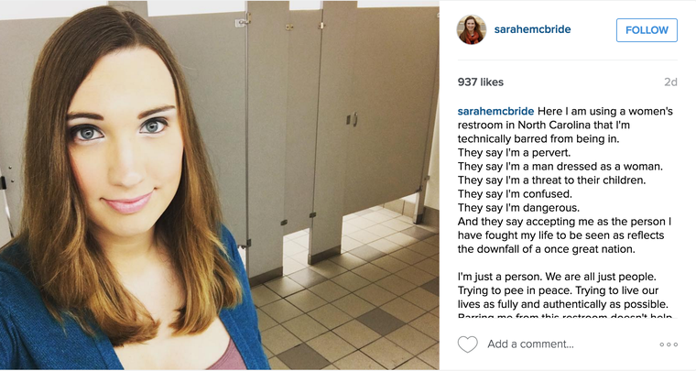
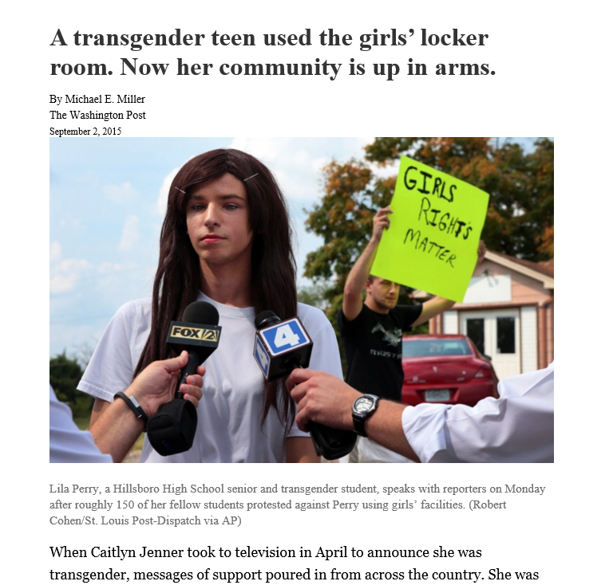
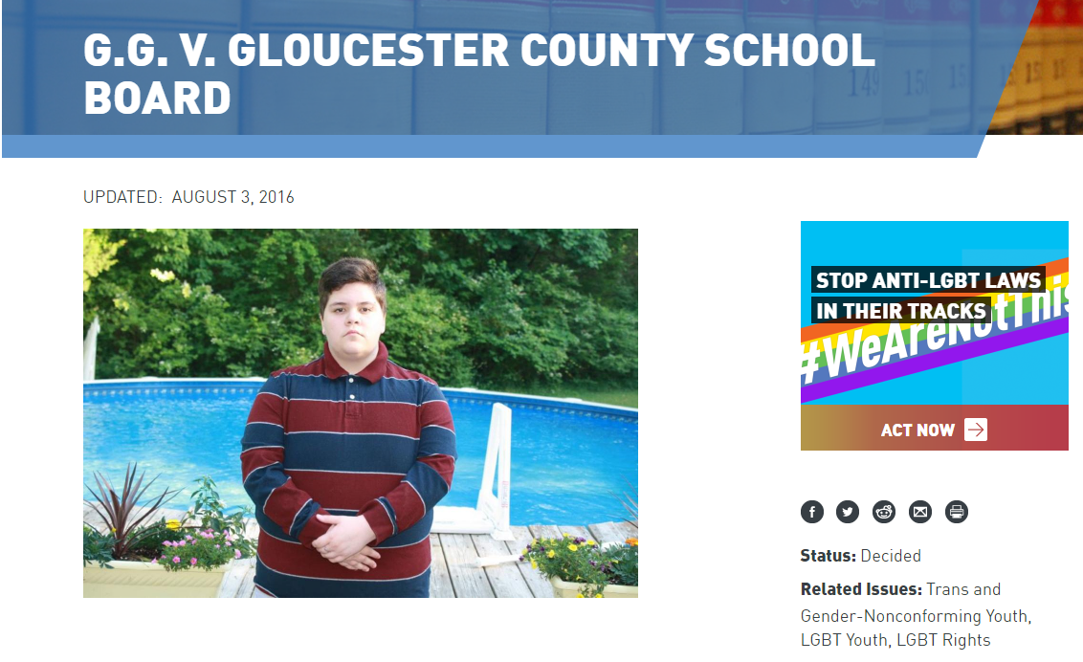
Notes:
JW

Slide 40
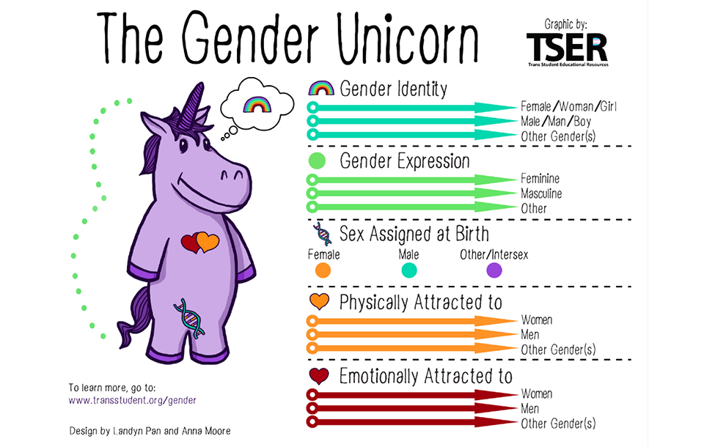

Slide 41
Addressing Bathroom Use
Don’t assume a person’s gender or gender identity
Don’t stop someone from going in a bathroom
Address policy violations
If someone complains about bathroom use
Notify them HCC’s practice is to allow people to use the bathroom consistent with their gender identity
Tell them if they don’t feel comfortable they can use an all gender bathroom or single use bathroom
Direct to Title IX coordinators with further questions

Slide 42
Q+A

