Slide 1

PATHWAYS TO TITLE IX AWARENESS
HOWARD COMMUNITY COLLEGE
WHAT ARE THE POLICIES AND WHAT IS YOUR ROLE?
Zakia Reaves- Johnson,
Director of Student Conduct & Compliance, Title IX Deputy
Coordinator

Slide 2
Welcome!
Howard Community College

Slide 3
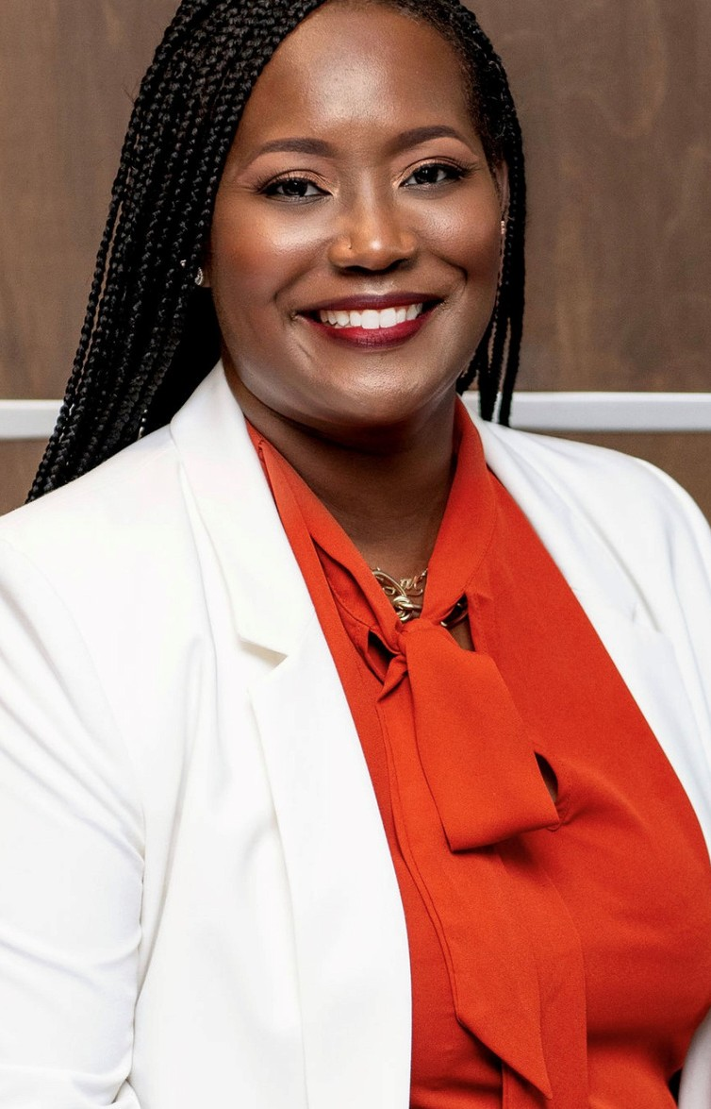
WHO AM I?
ZAKIA REAVES- JOHNSON
Zakia Reaves-Johnson is currently the Director of Student Conduct, Deputy
Title IX Coordinator, and Executive Associate to the Vice President of Student Success at Howard Community College. Prior to this role, she served as the
Interim Associate Vice President of Enrollment Services and before that the Director of Testing.
She first joined the HCC family in 2009, as a Counselor for the Student
Support Service program where she provided transfer, career, and personal counseling to first-generation, students with disabilities, economically
disadvantaged and at-risk students.
Zakia Johnson received a Bachelor’s degree in Criminal Justice and Master’s degree in Higher Education Administration & College Counseling from the
University of Delaware. She is currently pursuing her doctoral degree in Higher Education with a concentration in Community College Leadership at Morgan
State University.

Slide 4

Overview
WHAT IS SEXUAL MISCONDUCT?
WHAT ARE HCC'S SEXUAL MISCONDUCT POLICIES?
WHAT HAPPENS IF SEXUAL MISCONDUCT OCCURS AT HCC?
HOW CAN WE PREVENT SEXUAL MISCONDUCT?
THE IMPORTANCE OF BEING STUDENT-CENTERED AT HCC
WHAT ROLES DO TITLE IX COORDINATORS & TITLE IX DEPUTIES PLAY?
Howard Community College

Slide 5

Where does it happen?
On college campuses--we know that 1 in 5 women will experience sexual assault.
Before the age of 18, between 1 and 6 and 1 in 20 men will
experience sexual abuse.
Women have 1 in 3 chance of experiencing interpersonal
violence in their lifetimes.

Slide 6
Where does it happen?
1 in 4 men reported experiencing sexual violence in their lifetime.
1 in 6 women and 1 in 19 men experience stalking.
Sexual assault rates for LGBTQ individuals and people of color are equal to or higher than the general population
(Green Dot 2.0, 2014)

Slide 7

WHAT IS SEXUAL MISCONDUCT?
Title IX
No person in the United States shall, on the basis of sex, be excluded from participation in, be denied the benefits of, or be subjected to discrimination under any education program or activity receiving Federal financial assistance
(Title IX of the Education Amendments of 1972)

Slide 8


WHAT IS SEXUAL MISCONDUCT?
Title IX:
Prohibits discrimination on the basis of sex
Prohibits sexual misconduct and harassment
Sex can include gender identity

Slide 9


TITLE IX REG UPDATES
Clearly protect students and employees from all forms of sex discrimination
Provide full protection from sex- based harassment.
Protect the right of parents and
guardians to support their elementary and secondary school children.

Slide 10
TITLE IX REG UPDATES
Protect students and employees who are pregnant or have pregnancy-related conditions.
Require schools to take prompt and effective action to end any sex discrimination in their education programs or activities – and to prevent its recurrence and remedy its effects.

Slide 11
TITLE IX REG UPDATES
Require schools to respond promptly to all complaints of sex discrimination with a fair and reliable process that includes trained, unbiased decision makers to evaluate all permissible evidence.

Slide 12
TITLE IX REG UPDATES
Protect LGBTQI+ students from discrimination based on sexual orientation, gender identity, and sex characteristics.

Slide 13
TITLE IX REG UPDATES
Clarify and confirm protection from retaliation for students, employees, and others who exercise their Title IX rights.

Slide 14
TITLE IX REG UPDATES
Improve the adaptability of the regulations’ grievance procedure requirements so that all recipients can implement Title IX’s promise of nondiscrimination fully and fairly in their educational environments.

Slide 15
TITLE IX REG UPDATES
Improve the adaptability of the regulations’ grievance procedure requirements so that all recipients can implement Title IX’s promise of nondiscrimination fully and fairly in their educational environments.

Slide 16

SEXUAL HARRASSMENT
Any unwelcome sexual advance, unwelcome request for sexual favors, or other unwelcome verbal or physical conduct of a sexual nature when:
Quid pro quo (favor for a favor)
Has the purpose or effect of creating a hostile environment or unreasonably interfering with an individual’s work or academic performance

Slide 17
Verbal harassment or abuse
Pressure for sexual activity
EXAMPLES OF SEXUAL
HARRASSMENT
Unwelcome touching
Quid pro quo (favor for a favor)
Displaying or sending explicit images or using explicit language
Threatening to commit a violation of sexual misconduct
Howard Community College

Slide 18



SEXUAL ASSAULT
Any type of sexual contact or behavior that occurs without the explicit consent of the recipient
Incest
Non-consensual sexual contact Touching of intimate body parts
Non-consensual sexual intercourse Penetration

Slide 19

CONSENT
Permission to act through words or actions
Clear, voluntary, mutually understood, for each act Active not passive
Given freely, no use of force or coercion Knowingly, cannot be under 16 or incapacitated Specific- permission for each activity

Slide 20
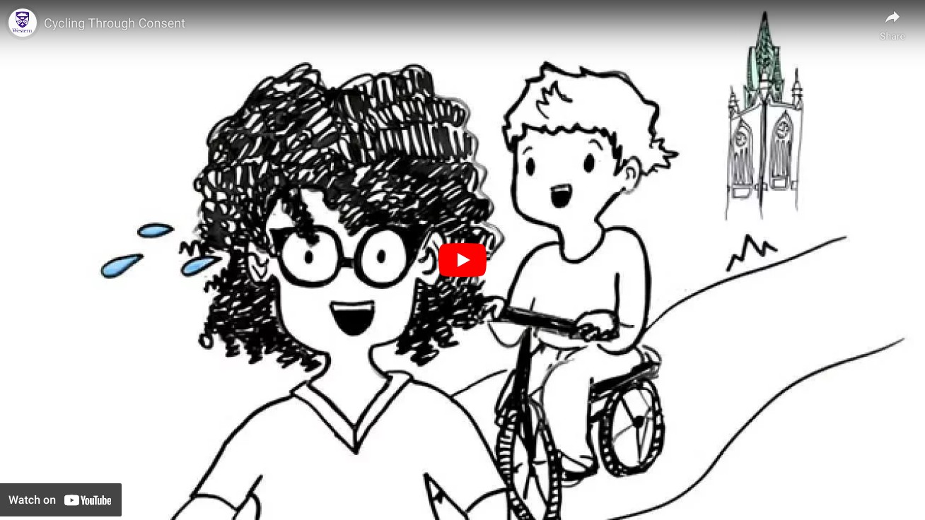
CONSENT

Slide 21

SEXUAL EXPLOITATION
Taking non-consensual or abusive sexual advantage of another to benefit anyone other than the person being exploited

Slide 22
Sexual voyeurism
Invading privacy
Going beyond the boundaries of consent
(such as letting someone hide in a closet to watch you having consensual sex)
Video or audio recording of sexual acts or private activities without consent
Sharing images without consent
Knowingly exposing someone to a sexually transmitted infection (STI) without their knowledge
Administering drugs or alcohol to someone without their knowledge
Exposing genitals without consent
SEXUAL
EXPLOITATION
Howard Community College

Slide 23



Violence or threat of violence between individuals:
In a personal and private social relationship of a romantic or intimate nature
DATING/
DOMESTIC VIOLENCE
Current or former spouse
Person with whom a child is shared Person cohabitating
Howard Community College

Slide 24
Course of conduct that alarms or seriously annoys
the person or makes them fear for their safety or that of family or friends
STALKING
Includes cyber-stalking
Intentionally following another person without their
consent
Howard Community College

Slide 25
Repeated, unwanted/unsolicited contact
Face-to-face contact
Phone calls
Voice messages Text messages Email
Social media use Unwanted gifts
STALKING
Repeatedly showing up or waiting outside a person’s home,
classroom, place of employment, or vehicle
Howard Community College

Slide 26

WHAT HAPPENS IF SEXUAL MISCONDUCT OCCURS?
Report it to HCC Any employee Public Safety 443-518-5555
443-518-5500
Title IX Coordinators
Report it to police Report it to both
Consult with confidential resources
Third party reporting
Howard Community College

Slide 27

CONFIDENTIAL RESOURCES
HCC Counseling Center or other counseling services Hopeworks
Medical staff operating in a medical capacity
Howard Community College

Slide 28


WHAT
HAPPENS IF SEXUAL
Interim Measures
Options to address formally or informally
Informal options
Continued interim measures Conversation with student
MISCONDUCT OCCURS?
Howard Community College

Slide 29
Formal
HCC investigates
Potentially meets with: Complainant
Respondent Witnesses
Determination if incident should go to hearing or employee process
Hold hearing or employee process
Deliver outcome including sanctions Appeal if necessary
WHAT
HAPPENS IF SEXUAL
MISCONDUCT OCCURS?
Howard Community College

Slide 30
Academic accommodations
Assistance in arranging for alternative college
employment arrangements or changing work schedules A “no contact” order
Providing a public safety escort
Assistance identifying an advocate to help secure additional resources
Other measures the complainant would like to request
INTERIM
MEASURES
Howard Community College

Slide 31
What is your role?

Slide 32
Someone who is present at an event with the
opportunity to participate or intervene.
BYSTANDER
Howard Community College

Slide 33
Someone who is present at an event and
intervenes
ACTIVE
BYSTANDER
Howard Community College

Slide 34
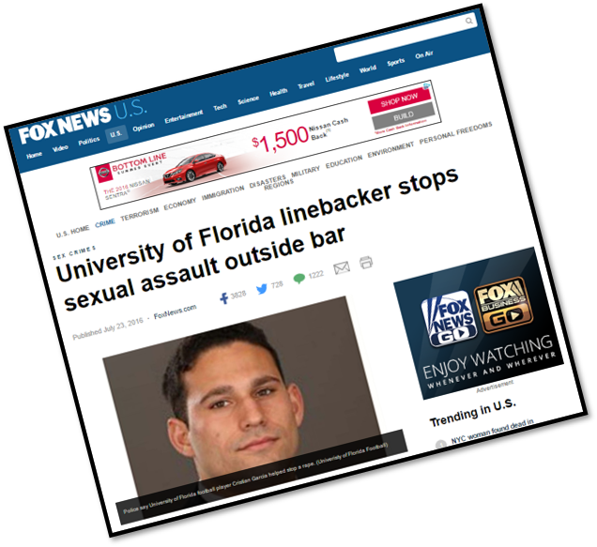
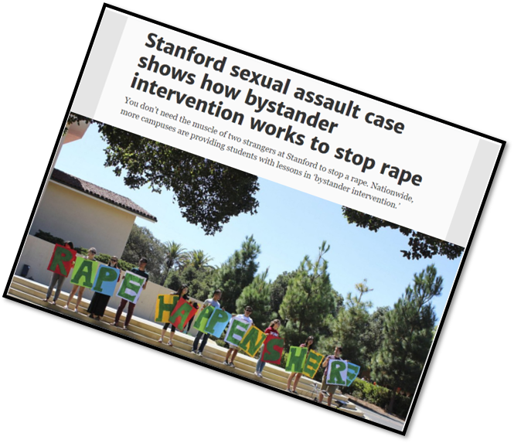
Bystander Intervention
Howard Community College

Slide 35

WHAT
CAN YOU DO TO PREVENT
Notice the event
Interpret it as potentially a problem Assume responsibility
Know how to help Step up and help!
SEXUAL
MISCONDUCT?
(Latane and Darley, 1968)
Howard Community College

Slide 36
DIRECT
Confront a situation. When safe, being direct is the most immediate way to intervene in a situation.
DISTRACT
Know How To
Help
Perhaps you do not want to address a situation directly then you can try to cause a distraction
that will diffuse the situation and give a moment for things to calm down.
DELEGATE
If you cannot intervene directly in something because there is a barrier that makes you
uncomfortable, then enlist help. You do not have to do it alone.
Howard Community College

Slide 37
WHAT WOULD YOU DO?
You’re sitting in the café with a group of colleagues, and a man comes up to a woman in the group and says “I saw you walking across campus, and that a** is fine. Oh the things I would do”
Direct: Tell the man to knock it off.
Direct: Ask the woman if she is comfortable with the comments.
Delegate: Ask the man’s friends to get the man to stop 4. Distract: Say “XXXX that test I just had was so hard.”
Howard Community College

Slide 38
WHAT WOULD YOU DO?
You’re walking across the quad, and you see a couple arguing. One person is cornering their partner by Duncan Hall, yelling and not letting them leave.
Direct: Go up to the couple and ask if everything is okay.
Delegate: Get your more confident, stronger friend to go up and intervene.
Delegate: Call public safety.
Distract: Walk by them, trip and drop your books. 5. Distract: Walk up and ask them where the library is
Howard Community College

Slide 39
Student-Centered
We are trying to build our students into responsible scholars and citizens.

Slide 40
Student-Centered
“In business the customer is always right; however in education the student is not always right. An important part of college involves students learning from their mistakes and facing the consequences
of their actions."

Slide 41
Logic
Emotion
Communication
A Delicate Balance

Slide 42

Resources
Howardcc.edu/titleix Student Handbook
Hopeworks
www.wearehopeworks.org Title IX Coordinators

Slide 43
What role do we play?
The Title IX Coordinator and the Deputy
Coordinators work to resolve complaints of sexual misconduct, sexual harassment, and
gender-related violence, including stalking and intimate partner violence involving students and employees at HCC.

Slide 44
What role do YOU play?
In order to facilitate a culture of inclusion and belonging, HCC relies on a well-staffed Public Safety Department to monitor the campus
environment and respond to potentially harmful activities. The department supplies an annual
campus crime report and provides one of
multiple venues for students to report incidents on campus.

Slide 45




Resources
Title IX Coordinators Dr. Melissa R. Curtis Mr. Joseph Whalen
Title IX Deputy Coordinators Ms. Zakia Reaves-Johnson Ms. Christy Koontz

Slide 46
MY CONTACT INFO
ZAKIA REAVES-JOHNSON
Email | zjohnson@howardcc.edu Phone Number | 443.518.4079
Howard Community College

Slide 47
Here's to a Successful & Safe
Year!
Howard Community College

