Slide 1

HOWARD COMMUNITY COLLEGE
PREVENTING
SEXUAL
MISCONDUCT
AT HCC:
WHAT ARE THE POLICIES AND WHAT IS YOUR ROLE?
Christy Lee Koontz,
Associate Director of Student Conduct & Compliance, Title IX Deputy Coordinator
RCF 331
443.518.3182 – Office
301.693.4394 – Direct
ckoontz@howardcc.edu

Slide 2
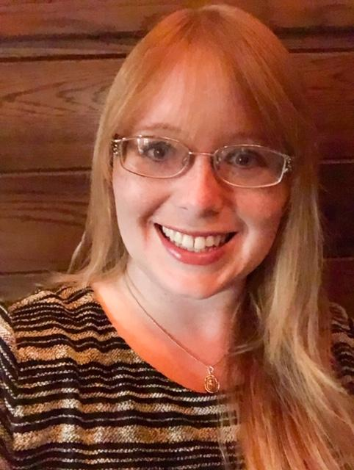
WHO AM I?
Christy Lee Koontz
Christy Lee Koontz is currently the Associate Director of Student Conduct & Compliance and Deputy Title IX Coordinator at Howard Community College (HCC). Prior to this role, she spent ten (10) years at the University of Baltimore and served as the Assistant Dean of Students.
She has spent her career helping to provide support services to students in the areas of student conduct and behavior, Title IX, veterans’ services, disability support, counseling services, cohort support, residence life and admission and advising.
Christy received a Bachelor’s degree in Political Science, Philosophy and Conflict Negotiations and Conflict Management from Salisbury University and a Master’s degree in Negotiations and Conflict Management from the University of Baltimore. She is a certified mediator, arbitrator and facilitator.

Slide 3
Creating a Campus Culture of Wellness, Safety & Healthy Relationships

Slide 4

SAFETY
Goals of the Office of
Student Rights and Responsibilities
To protect members of the campus community from harm resulting from the indiscretions of the few members of the community who are unable, or unwilling, to respect the rights of others;
LEARNING ENVIRONMENT
To create an environment that enhances the opportunity for learning;
PROTECT RIGHTS OF STUDENTS
To protect the rights of members of the college community and assure students due process when they have been accused of violating college rules and/or regulations

Slide 5

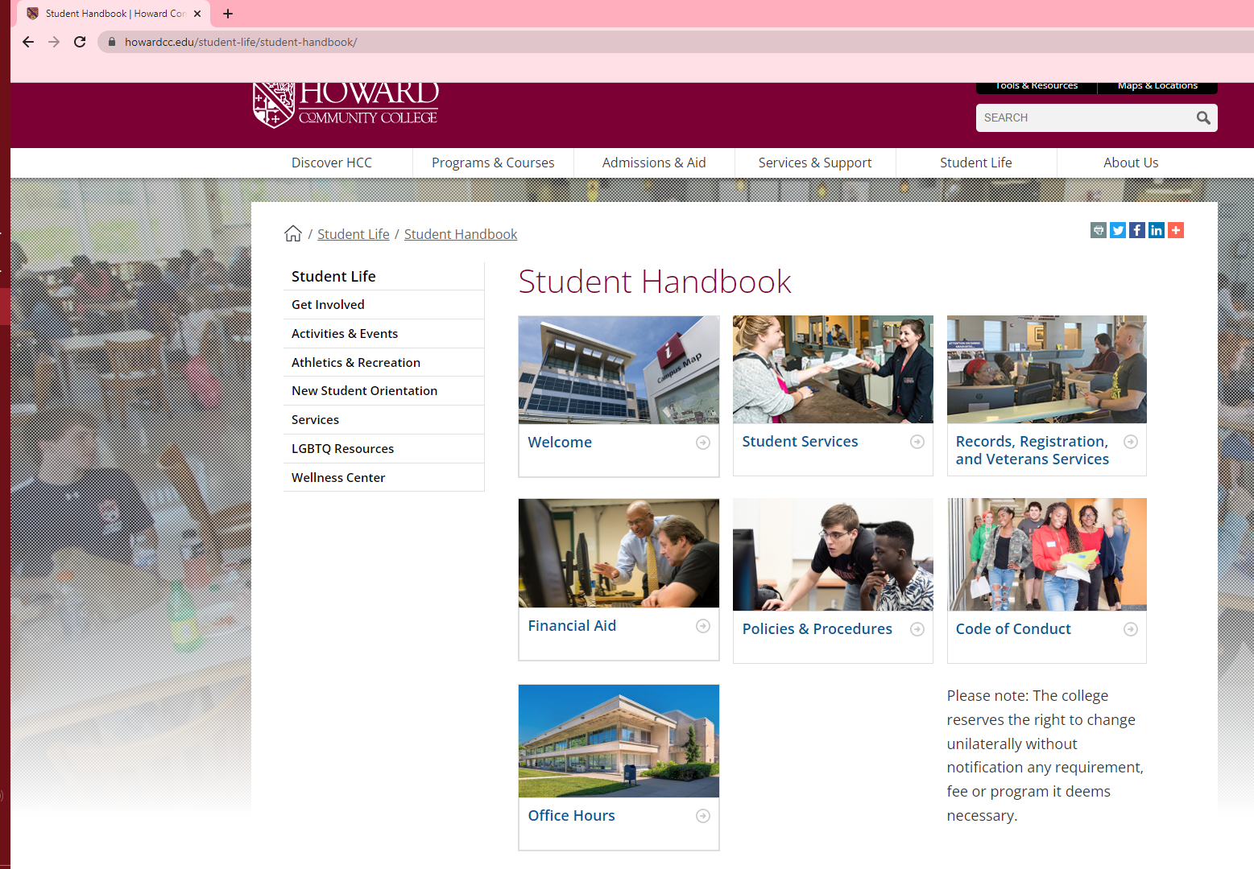

STUDENT HANDBOOK
https://www.howardcc.edu/student-life/student-handbook/

Slide 6

WHAT IS SEXUAL MISCONDUCT?
Title IX
No person in the United States shall, on the basis of sex, be excluded from participation in, be denied the benefits of, or be subjected to discrimination under any education program or activity receiving Federal financial assistance
(Title IX of the Education Amendments of 1972)
No

Slide 7

WHAT IS SEXUAL MISCONDUCT?
Title IX
  Prohibits discrimination on the basis of sex
  Prohibits sexual misconduct and harassment
  Sex includes gender identity

Slide 8
Why it’s important?
  1 in 4 men reported experiencing sexual violence in their lifetime.
  1 in 6 women and 1 in 19 men experience stalking.
  Sexual assault rates for LGBTQ individuals and people of color are equal to or higher than the general population
  On college campuses--we know that 1 in 5 women will experience sexual assault.
  Before the age of 18, between 1 and 6 and 1 in 20 men will experience sexual abuse.
  Women have 1 in 3 chance of experiencing interpersonal violence in their lifetimes.
(Green Dot 2.0, 2014)

Slide 9

TYPES OF SEXUAL MISCONDUCT?
  Sexual harassment
  Sexual assault
  Sexual exploitation
  Dating/domestic violence
  Stalking

Slide 10

SEXUAL HARRASSMENT
Any unwelcome sexual advance, unwelcome request for sexual favors, or other unwelcome verbal or physical conduct of a sexual nature when:
(1) Quid pro quo
(2) Has the purpose or effect of creating a hostile environment or unreasonably interfering with an individual’s work or academic performance

Slide 11
SEXUAL ASSAULT
Any type of sexual contact or behavior that occurs without the explicit consent of the recipient
  Incest
  Non-consensual sexual contact
    Touching of intimate body parts
  Non-consensual sexual intercourse
    Penetration

Slide 12

SEXUAL EXPLOITATION
Taking non-consensual or abusive sexual advantage of another to benefit anyone other than the person being exploited​

Slide 13
DATING/DOMESTIC VIOLENCE
  Violence or threat of violence between individuals:​
    In a personal and private social relationship of a romantic or intimate nature​
    Current or former spouse​
    Person with whom a child is shared​
    Person cohabitating

Slide 14
STALKING
Course of conduct that alarms or seriously annoys the person or makes them fear for their safety or that of family or friends​
  Includes cyber-stalking
  Intentionally following another person without their consent ​

Slide 15
CONSENT
  Permission to act through words or actions
  Clear, voluntary, mutually understood, for each act
  Active not passive
  Given freely, no use of force or coercion
  Knowingly, cannot be under 16 or incapacitated
  Specific- permission for each activity

Slide 16

CONSENT
https://www.youtube.com/watch?v=fGoWLWS4-kU

Slide 17
  HCC can provide direct support to students who experience sexual misconduct regardless of whether or not the accused an HCC community member. Support measures can be provided to address and help remediate concerns.
  If the accused is an HCC community member, there are both informal and formal adjudication options to address concerns in addition to support measures.
  The college will only be required to act against a complainant’s request if the report raises concerns of immediate, ongoing risk to the health, safety and welfare of the campus community.
WHAT HAPPENS IF SEXUAL MISCONDUCT OCCURS?​

Slide 18
Where You Can Turn
For Help?
  Report it to HCC​
  Any employee​
  Public Safety​
  443-518-5555​
  443-518-5500​
  Title IX Coordinators​
  Report it to police​
  Report it to both​
  Consult with confidential resources​
  Third party reporting​
All HCC Faculty and Staff
(except for counselors in the Counseling Center) are
Mandatory Reporters

Slide 19
CONFIDENTIAL RESOURCES
  HCC Counseling Center or other counseling services​
  Hopeworks​
  Medical staff operating in a medical capacity​

Slide 20
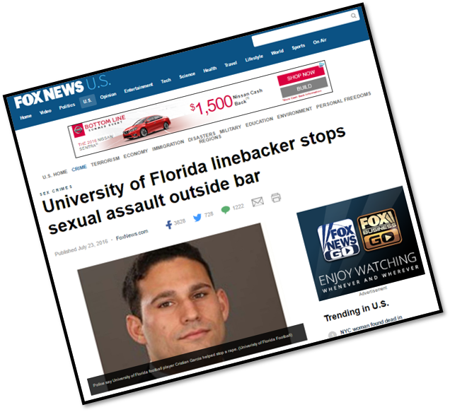
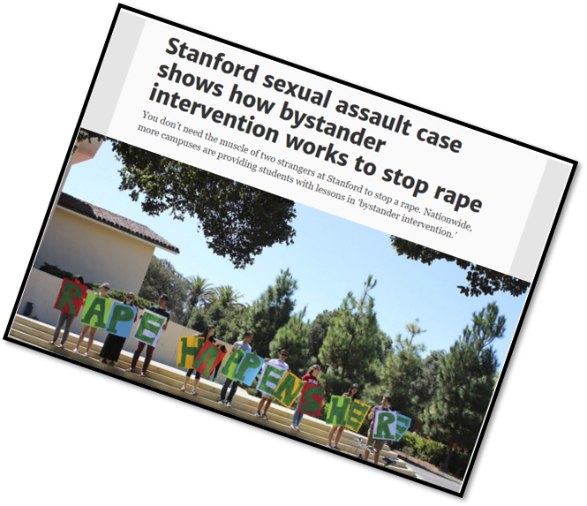
WHAT
CAN YOU
DO TO
PREVENT SEXUAL MISCONDUCT?

Slide 21

DIRECT
Confront a situation. When safe, being direct is the most immediate way to intervene in a situation.
Ways You Can Help
DISTRACT
Perhaps you do not want to address a situation directly then you can try to cuase a distraction that will diffuse the situation and give a moment for things to calm down.
DELEGATE
If you cannot intervene directly in something because there is a barrier that makes you uncomfortable, then enlist help. You do not have to do it alone.

Slide 22
Resources
  Howardcc.edu/titleix​
  Student Handbook​
  Hopeworks​
  www.wearehopeworks.org​
  Title IX Coordinators​
    Dr. Shantay Grays
    Mr. Joseph Whalen
  Title IX Deputy Coordinators​
    Ms. Zakia Reaves-Johnson
    Ms. Christy Koontz

Slide 23
Have a GREAT semester at HCC!
Howard Community College

